Slide 1

An Introduction to Phonics and Early Reading.

Slide 2
Welcome!
What is phonics?
The alphabetic code
Blending
Reading and books
Reading at home
Spelling
Concerns about progress
Questions and next steps
Notes:
Welcome parents to the session.
We are very excited you are here to learn about your child’s ‘reading’ journey.
Explain how you are structuring the session/ sessions to give them information about how early reading is taught at your school and how they can play a vital role in supporting their child’s reading journey.

Slide 3

We love reading!
Reading for pleasure
Finding out information
Reading the world around them
Understanding forms and official documents
Accessing learning
Notes:
Reading is at the heart of our curriculum at verwood and it is one of the most important things we can teach our children. We want all our children to be avid readers with a love for all different types of literature.
Think of reading activities you do everyday….
As children start their school life they will very much focus on learning to read. As they move higher up the school and into secondary education and beyond they will be reading to learn. So it is vitally important that we support our youngest pupils to quickly learn to read. We want every child to love reading and to do this we must make sure that it is a pleasurable experience and that they can read with accuracy and fluency so they can access as many opportunities as possible.
At Verwood we make sure that there are lots of opportunities to enjoy reading - daily story times where teachers share their passion and enthusiasm for books, library time and when children bring home a ‘Reading for Pleasure’ book each week.

Slide 4
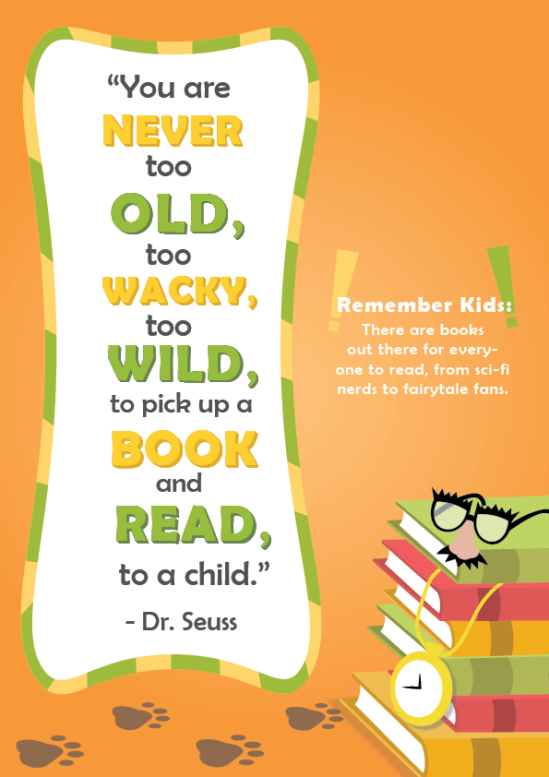
What is Phonics?
Phonics is the link between the words we read/say and the letters that represent each sound.
Phonics Terminology
Phoneme - A single spoken sound, e.g. /c/
Grapheme - A grapheme is a letter or a sequence of letters that represent a phoneme/sound.
Phoneme/Grapheme Correspondence - match a phoneme (sound) to a grapheme (written representation)
Segment - Segmenting a word is to break the word down into its component phonemes, e.g. hat = h-a-t.
Blend - Blending letter sounds (phonemes) together enables children to decode and read words. For example, h-a-t = hat.
Notes:
Over the past 50 years schools have taught children to read using lots of different approaches. But, thanks to research we know that phonics is the best way to teach children to read. We know this might be different to how you were taught to read so we hope this session helps you to understand what phonics is, how we will teach phonics at our school and how you can help your child to learn to read.
The national curriculum says that phonics should be the main way that schools teach children to read. The Department of education have recently approved phonics schemes that meet its criteria of a good scheme. Our school has chosen to use a scheme called Unlocking Letters and Sounds.
All schemes are slightly differently but , as a school , we think this is the best one for our pupils. All children in the school will use Unlocking Letters and Sounds to teach their phonics and early reading. All staff , including TA’s, have had training with this scheme so they are experts at using it. We are also building on that initial training on further INSET days.
When we say a word we say lots of sounds very quickly – so quickly we hardly notice the sound each letter makes.
If we say the word CAT.
And now say the sounds in the word CAT
We can hear…3 phonemes…c/a/t. When we write the word cat we represent each phoneme using a grapheme/letter.
This is phonics!
There is some technical vocabulary that we use for phonics and that your children will use.
Grapheme – the written letter or groups of letters
Phoneme – the sounds that the grapheme makes.

Slide 5
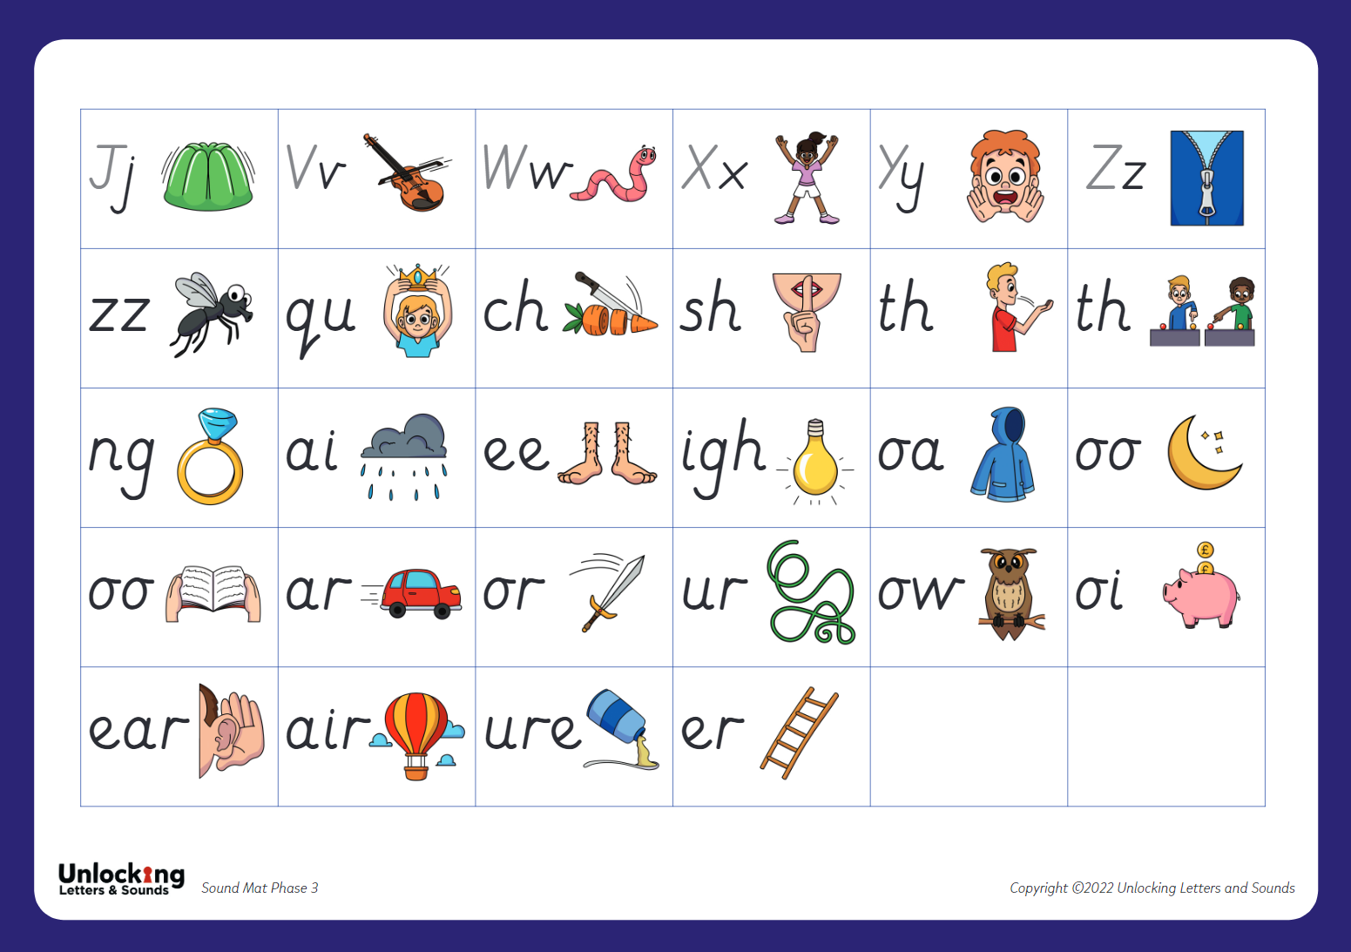
Correct Pronunciation
Phase 2 Actions
Phase 3 Actions
Notes:
As children start to learn their grapheme phoneme correspondences (GPCs) it is very important that we pronounce the sounds clearly and purely.
We also help them to learn and remember the GPCs in Reception with an image and action for each phoneme.
Your children will be coming home sharing the actions with you so do join them when they are using them! There are actions for phase 2 and 3 not for 5.
Play video of phase 3 pronunciation and actions for some of the first GPCs children will be learning. Jaw tip!

Slide 6
The Alphabetic Code
44 phonemes
Simple Code
Complex Code
Notes:
The English language is made up of about 44 different sounds in different combinations – it is one of the most complicated languages. It will take most children about three years to learn the alphabetic code and to use it to read and it is one of the most important things we teach in Reception and Key Stage 1.
We know that children won’t learn to read by themselves so we will be teaching phonics every day to help them learn.
Your children will have a daily phonics lesson from Reception until Year 2. They will be taught by their teacher in the whole class and each lesson will last about 25 minutes.
Your child will learn 4 new GPCs each week – we organise the phonemes into sets. These sets are then put into phases.
Progressive programme - In reception children will be taught Phases 2 – 4. They will be taught phase 5 in years 1 and 2.
When we start this decoding journey we will keep things very simple. We will teach basic phonemes and their matching graphemes (such as cat and map). This means that children rapidly learn and understand and to build confidence in their reading. This teaching will start straight away in Reception.
We’ve looked at examples where a phoneme is represented by a single letters.
Some sounds are represented by graphemes that have two or more letters.
Eg. Sh o p th i n r i ch
The sounds sh, th and ch are represented by two letters – these are called digraphs.
Some sounds are represented by three letters:
Eg. L igh t
The sound igh is represented by 3 letters - this is called a trigraph.
Your child will be coming home telling you all about phonemes, graphemes, digraphs and trigraphs! They will be fantastic at understanding this vocabulary as they are learning the alphabetic code and you can help by using these words at home.
As your children continue to learn to read they alphabetic code will become more complex. They will learn about sounds that are represented by lots of different graphemes and how some graphemes can represent different sounds.
As they start Year 1 & 2 they will start to learn phonemes with alternative spellings eg: split digraphs a - e as in cake or alternative spellings ay (day)
The complexity of the English alphabetic code is why it takes so long to read. Many children will find different parts challenging – especially at first. But our staff are skilled at teaching phonics and will be gradually working through the alphabetic code so that every child become an expert reader.

Slide 7

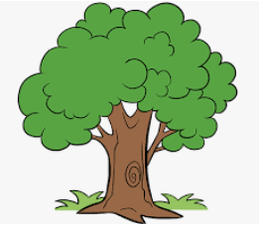
Blending
Pushing the phonemes together to make a word.
Sun Sun/ny Sun/flow/er
Notes:
As well as learning to recognise the graphemes and say the phonemes they represent we will be teaching children how to use these to read.
When we read a word we look at each graphemes and match a sound to it. We push the sounds together to make a word. This is called BLENDING.
Blending is a really important skills that children need lots of practice at – it will take lots of time!
Let’s have a go at blending a word: t / r / ee
We teach the children to read from left to right - identifying each grapheme and saying the phoneme. Once they have done that they go back and push the phonemes together to blend the phonemes together to read the word.
We want to teach children to recognise the grapheme quickly so they can blend it rapidly. Once they can do this their reading will become fluent – and less painful! But this really does take a huge amount of practise so it is really important that children practise this at home with the books we give them.
As children progress in their reading journey, so in Year 1 and 2, children, will begin to read longer words made up of multiple syllables – give the example of fun – funny – funniest
We teach these words by ‘chunking’ them into syllables and blending these chunks together. But we are still identifying the GPCs and blending them together.
This is what we will do as adults when we come across an unfamiliar word – use the example crepuscular. How would we read this unfamiliar word? We would chunk it and blend the syllables together.
This is why it’s really important to teach children to read using phonics – without this skills to decode the graphemes we would not be able to read unfamiliar words.

Slide 8

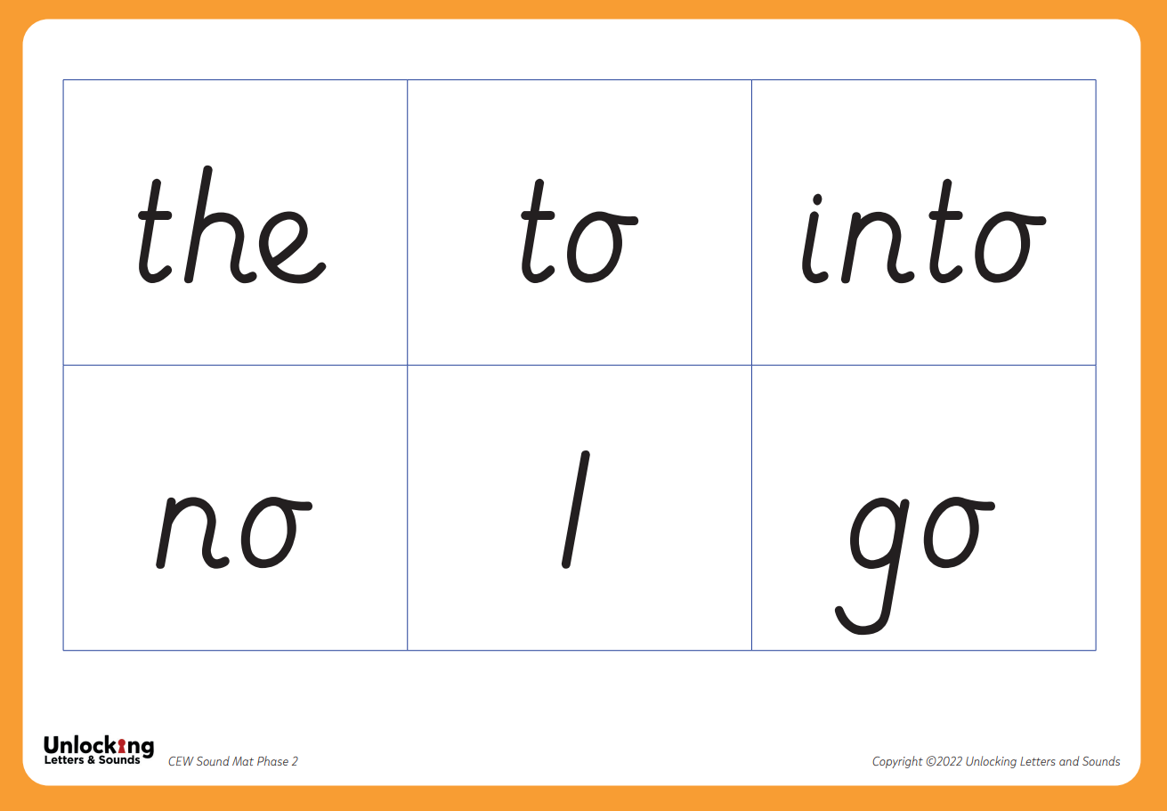
Common Exception Words
Notes:
There are some words that we use a lot in English such as the, like, said, were.
To give children’s reading a boost and so they can access more tests quickly we want children to learn these key words early on. Many of them have unusual patterns or GPCs that aren’t taught until later on.
So we teach children to recognise them by sight initially. Children will be able to decode some of them later on but , until they have learnt to decode them, we recognise them as key words. List of key words in handout.

Slide 9

Reading and Books
Children will be given books precisely matched to their phonic attainment - this will be different for every child.
The time spent reading with your child should be a celebration of your child’s reading - a chance to showcase their phonic expertise.
Notes:
Books are allocated to match the sets and phases that children are secure in.
Teachers assess all the children regularly so they know when each child is ready to move onto the next set - this takes a different amount of time for each child – some will need more practice than others.
Please don’t compare your child with others and contact us if you are worried about anything.
Children will be given a book that precisely matches their phonics attainment so that they can read at least 95% of the words in it. Please don’t think that this makes the book too easy for them – it’s vitally important that reading is a celebration of children’s reading with you and a chance for them to show their phonics expertise.
In school we will also be reading with children. They will read everyday in their phonics lessons .
In Reception children will be heard read 1-1 until they are ready to read in a small group with an adult.
In Year One children have 2 guided reading sessions each week (where they read in a small group with an adult)
In Year Two children have 2 guided reading sessions , where the teacher will listen to every child read for a short time during the lesson. Extra guided reading groups will take place for children who need more practice.

Slide 10
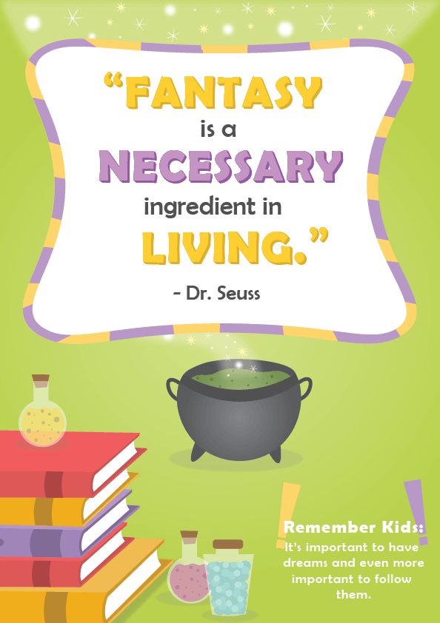
Why read each book 3 times?
Decoding and Vocabulary
Prosody (intonation, volume, pitch, rhythm).
Comprehension (Questions, predictions, characters feeling etc.).
Notes:
One of the most important ways to increase children’s accuracy, fluency and understanding of the book they are reading is to re-read the same books several times. This is why we only give 1 book at a time – we would like each book to be read at least three times with a different focus each time.
This films explains the value of re- reading the same book and what you should focus on each time. https://www.youtube.com/watch?v=Hhu3xeNq3Kg&t=200s

Slide 11

Once Phonics are Secure
Once children are secure in all their phonic sounds, can read fluently and are able to decode words independently, they will move onto colour banded books.

Slide 12

Once Phonics is Secure
At Pamphill, our colour banded books are matched to the children’s reading age.
Their reading age is assessed through an online tool, comprehension activities and reading with a teacher. We assesses the children’s reading and their understanding of the text (comprehension). This then allows us to match a book to their reading age.
Like the phonics readers, coloured banded books should be able to be read fluently and the emphasis broadens to encompass more comprehension and vocabulary understanding.
Children’s reading ages are reviewed throughout the year and their home reading books adjusted accordingly.
Notes:
Online assessments are carried out termly but we are continually assessing within class.

Slide 13
Reading at home
Your child reading to you.
5 – 10 minutes daily
Choose a time that works for you, get
comfortable and free from distractions.
Make it part of your routine.
Be positive and celebrate successes
Be patient and let them try and work it
out…if they need help…then work it out
together.
Remember your child is on an amazing
journey to becoming a reader.
Notes:
Reading at home is essential as it gives children the opportunity to practice their reading skills.
We know everyone is busy and children often don’t want to read out of schools.
You can make the magic happen! We can teach the children but the magic comes through the practicing - which you need to do. You are very much part of this journey with your child. Our top tips are: (on slide)

Slide 14
Reading at home
You reading to your child
Your child will also bring home a
‘Reading for Pleasure’ book , which will be chosen each week by them from our school library or classroom book corner.
This book is for you to read to your child and for you and your child to enjoy together.
By sharing this book together, you can further support your child by talking about the story, characters, exploring vocabulary and asking questions you will be
supporting their understanding, developing their comprehension skills and widening their vocabulary.
Spending quality time together.
Modelling how to read a book – tracking left to right, turning pages, identify title & illustrator.
Asking questions about what has happened and characters’ feelings.
Explaining vocabulary
Predicting what will happen next. How will the story end?
Making connections - personal links.
Share your love of reading!
Notes:
Whilst learning to decode and reading books that allow children to do this is important there is so much more to reading!
We know that decodable books are not the most exciting to read and alone, won’t give our early readers all the skills they need to develop a love of reading.
It is therefore important that you continue to read to your child and share a wide range of books with them – these should be books that children cannot decode themselves.
Reading books to children is a precious and lovely thing to do – we are sure you and your child already have favourite books that you share together!
By modelling reading and show how much you love reading you will be setting a fantastic example to your child.
When you read to your child you will want to:
Model how to read a book
Ask questions about what has happened to support your child’s comprehension or understanding of the text
Ask questions about characters’ feelings
Discuss the meaning of words and vocabulary
Ask children to predict what they think will happen next
Make connections with things your child has experienced or other books or films they have seen
Most importantly – show that you love reading! By modelling this you will support your child to develop their love of reading.

Slide 15
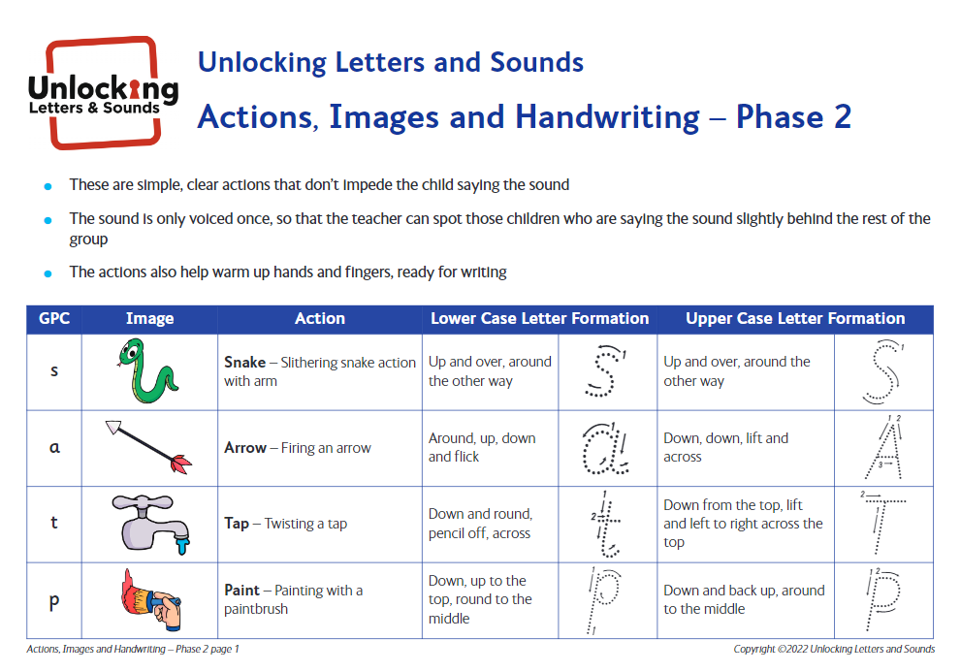

Spelling
Segmenting words
Daily writing as part of phonics lessons
Notes:
We know that when children are reading they are decoding the GPCs they know and blending them together to read a word or group of words.
We teach children to use their phonics to spell in the opposite way.
Instead of blending the phonemes together - to spell a words we separate the phonemes so we can hear each sound to be able to spell the word. This is called segmenting.
Let’s try segmenting this word to write it: m u g
Your child will write words, captions and sentences as part of their phonics lesson each day. As with reading, we will only ask them to write words contacting GPCs they have been taught. As part of their daily lesson we will also teach them how to write and form the letters they are writing.
We use a strategy throughout the whole school called tick and fix - Pupils will self assess and respond instantly.
We have a phonics first approach to spelling independently throughout KS1 and KS2
Handwriting - Year 1 continue pre cursive until child is ready to start joining. This might be towards the end of Year 1 or during Year 2 depending on the child.

Slide 16
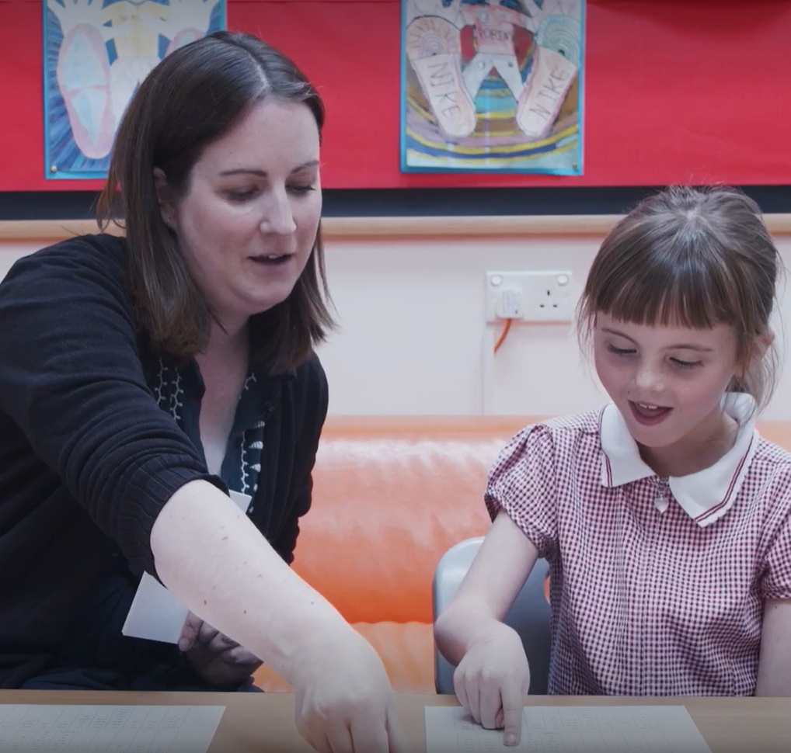
Concerns about progress
All children are different
Discuss any concerns with teachers
Teachers will assess your child regularly
Interventions to support child in the specific skill they are struggling with
Adaptations for children with SEND
Notes:
All children are different and, at different points in their learning, will find things more difficult or challenging. Staff at our school have all had training to identify what children are finding difficult and to help them overcome this.
We know if is very tempting to compare your child to others – especially with reading and what books they are on etc but we would suggest you speak to teachers if you have any concerns. If we have any concerns we will discuss them with you – and we might ask you to do some extra practice at home.
Teachers and TAs will assess your child regularly to check their learning. We quickly identify any child who might be at risk of falling behind and will support them with extra phonics- usually by giving them ‘interventions’ to support the specific skill they are struggling with – some children may struggle to identify the GPC, others might not be able to blend yet.
If a child has SEND we may need to make adaptations to their phonics eg. additional time to practice, more visuals . Again we will discuss these with you but research has shown that phonics is the most effective way of teaching children with SEND to read.

Slide 17
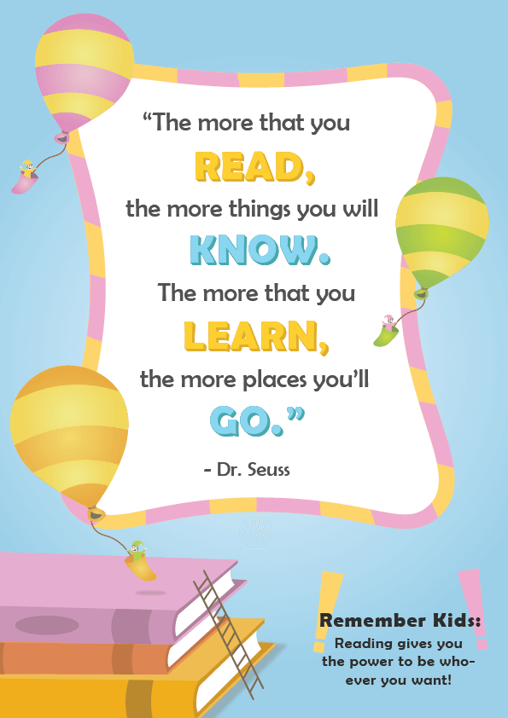
Thank you for coming.
Any questions?
Notes:
Learning to read is such an exciting journey for children and we are incredibly excited to be supporting your child through their journey at Verwood.
We hope today’s session has given you an understanding of how we teach phonics and reading at our school.
Ask for questions

