Slide 1
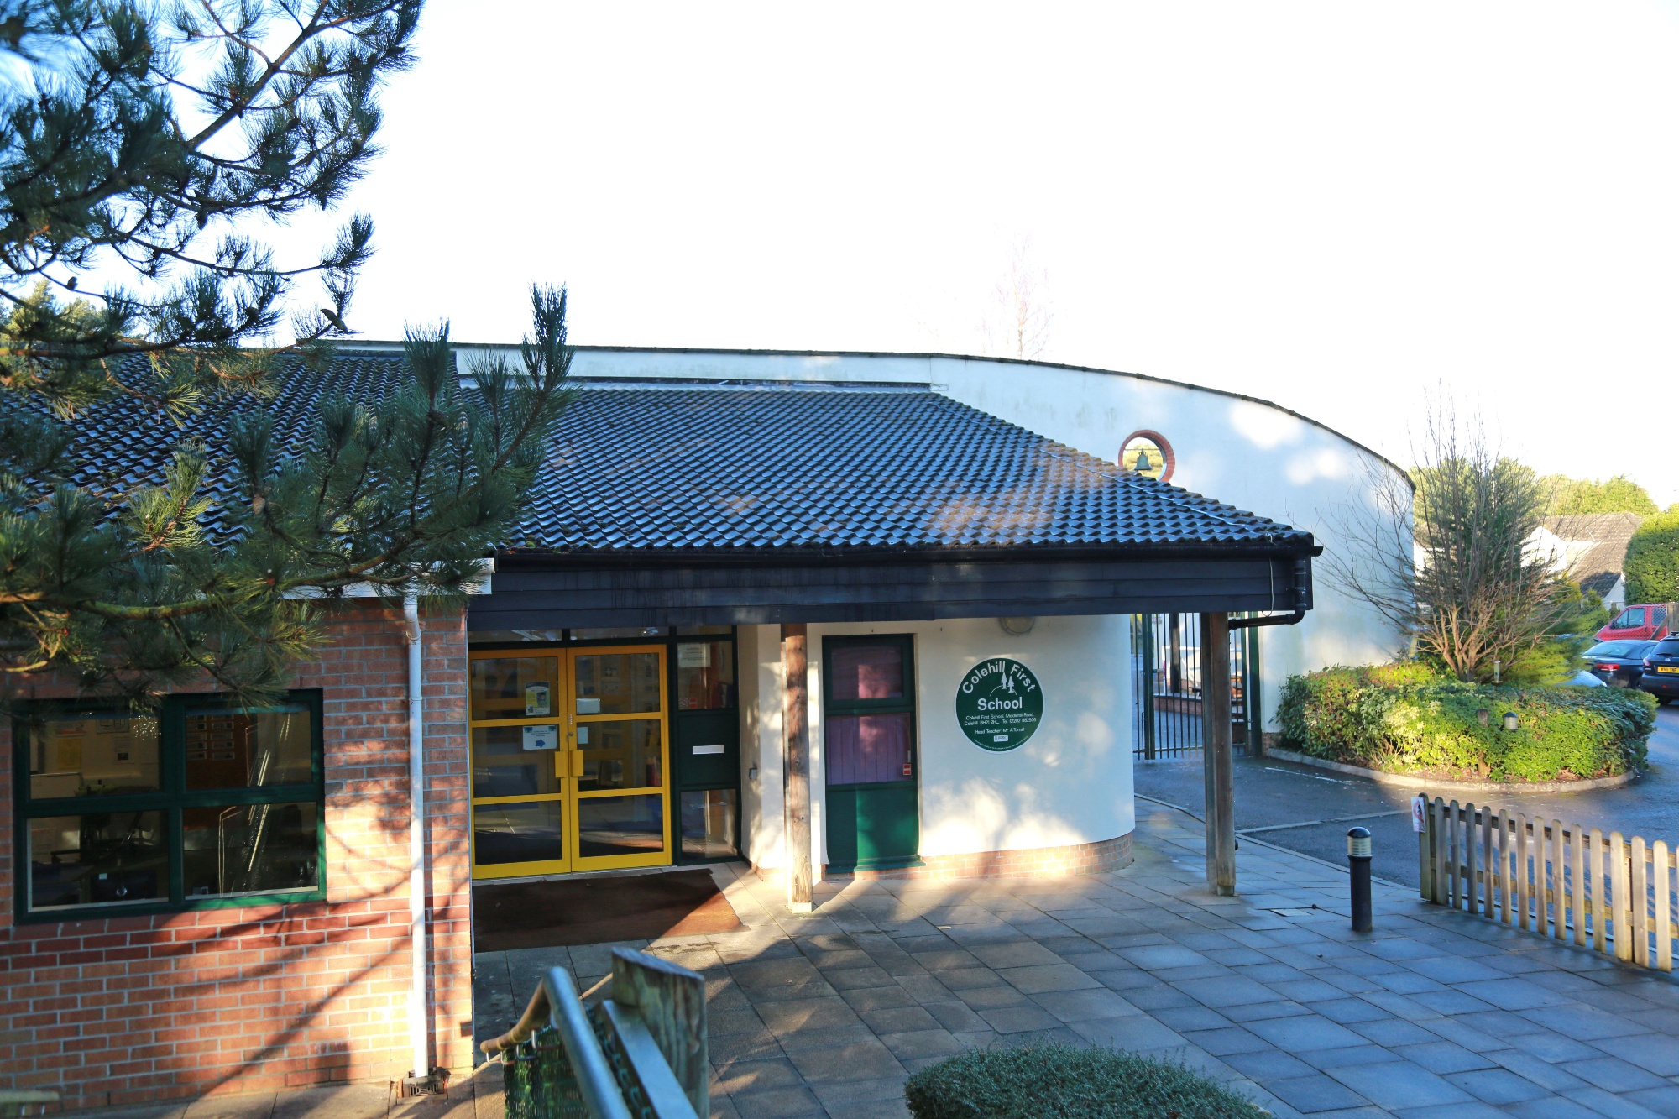
WHAT IS THE EYFS?
It’s the framework which sets the standard for the learning, development and care of children in England from birth to five years old.
It applies to all OFSTED-registered settings, including childminders, preschools, private nurseries, school settings.
It is based on the idea that children need to use concrete experiences to provide the building blocks of their learning.
It identifies seven areas of learning which link to KS1.
Notes:
Helen

Slide 2

*Every child is unique, they have different likes/dislikes, needs and interests.
*Children learn to be strong and independent through positive relationships.
*Children learn and develop well in enabling environments with teaching and support from adults, who respond to their individual interests and needs and help them to build their learning over time.
*Children develop and learn at different rates. The framework covers the education and care of all children in early years provision.
Notes:
Helen
What does the EYFS say about unique child?
All children develop in different ways and development is not a linear or automatic process. It depends on each unique child having opportunities to interact in positive relationships and enabling environments that encourage their engagement and recognise their strengths.

Slide 3
What Are Enabling Environments?
The emotional environment - an environment that is warm, welcoming and nurturing and facilitates a sense of belonging for every child.
The outdoor and the indoor environments – These are designed and resourced to reflect children’s interests, support pathways to progress, encourage exploration, promote language, support vocabulary, offer challenge and encourage independent thinking and action.
Children need rich, stimulating and playful experiences that connect purposefully to their interests and daily lives.
They need responsive adults who will support their thinking both spontaneously and in carefully planned intentional ways.
Notes:
Helen
Part of the joy of working in EYFS is that many spontaneous opportunities arise in well-resourced, play-based environments. When an unplanned situation arises we must take advantage of that opportunity.
Children learn in two major ways; When they play freely in well-resourced environments with adults sometimes intervening sensitively and when adults show children how to do things by modelling.

Slide 4
You Are Important To Us!
Working in partnership with parents and/or carers is central to the Early Years Foundation Stage (EYFS)
Consulting with you about your children's early experiences helps us to plan for effective learning, and helps us to support you in continuing your children's learning development at home.
Notes:
Helen
Contribution from parents to tapestry is invaluable

Slide 5
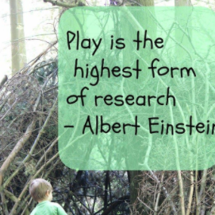
Play is essential to overall development because it contributes to the cognitive, physical, social, and emotional well-being of children.
It allows the child to use their creativity while developing their imagination, dexterity and emotional strength.
We scaffold children’s learning through play, being constantly mindful of their emergent development, what they are learning to do but can’t quite do yet.
Through play, we sensitively intervene to broaden their interests.
We are consistently assessing and planning ways to help your children to repeat, practice, enjoy and consolidate.
Notes:
Helen
we give them just enough help to achieve something they could not do on their own
introduce them to new experiences and widen their knowledge and vocabulary.
we intro new achievable challenges - resulting in a ‘can do’ attitude

Slide 6
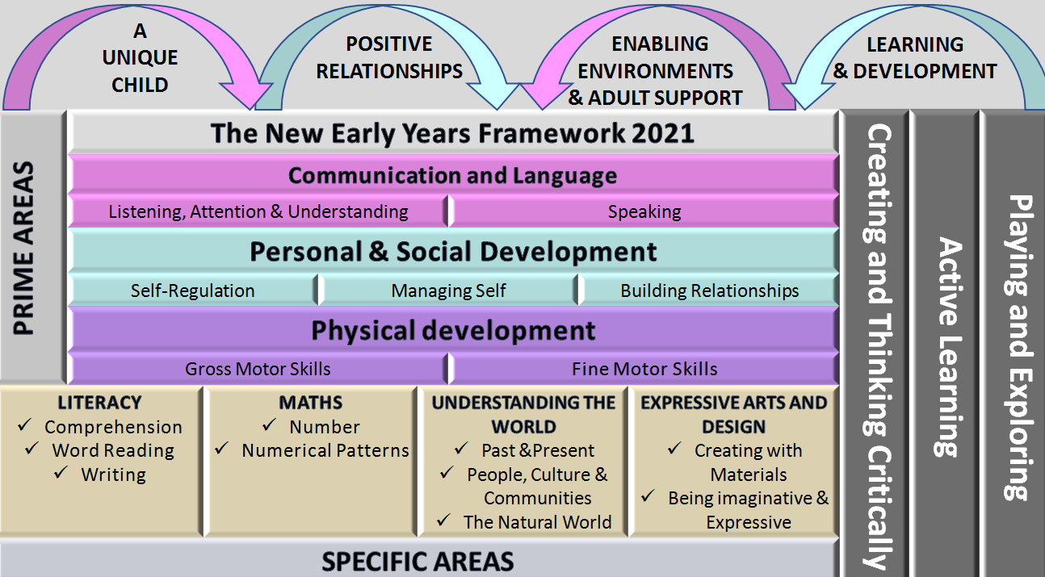
Notes:
Helen
The most important areas of the framework and child development are Communication, Personal&Social and Physical.
The Prime Areas are more basic, life-long skills that pave the way for children to progress towards Specific Areas of Learning. The Specific Areas of Learning cannot be developed alone, and rely on the skills gained in the Prime Areas of Learning.

Slide 7
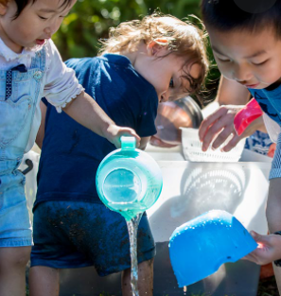
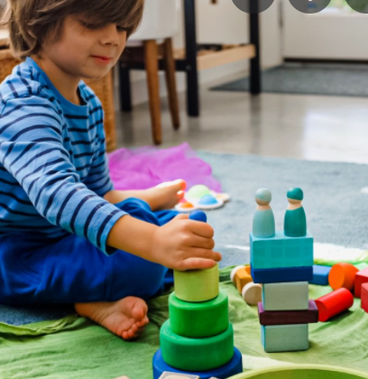
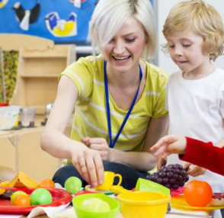
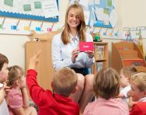
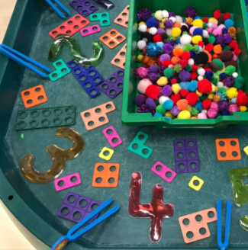
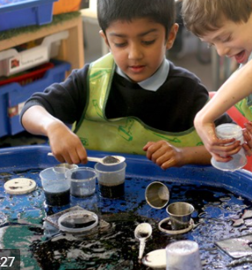


HOW MIGHT THIS LOOK?
Lots of play!
Open-ended activities to allow children to direct their own learning
1:1 and small group activities led by an adult​
Whole class teaching
Areas of learning overlapping
Learning often not-recorded by the child.
Mess, chaos, noise…engagement!
Learning not going as intended…but great learning nonetheless!
Notes:
Jemma

Slide 8
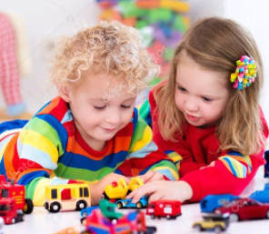
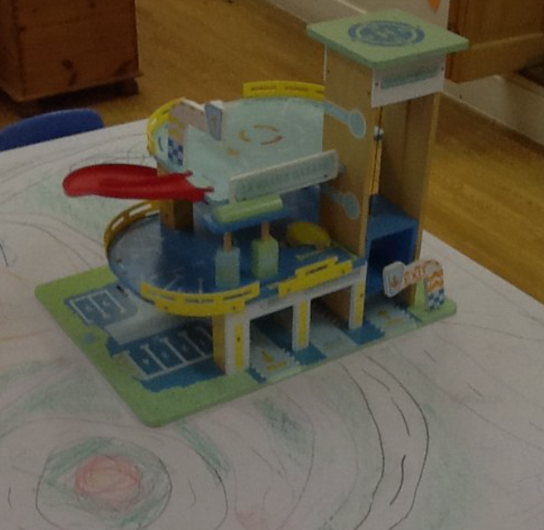
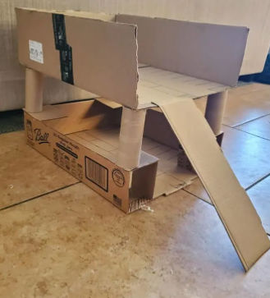
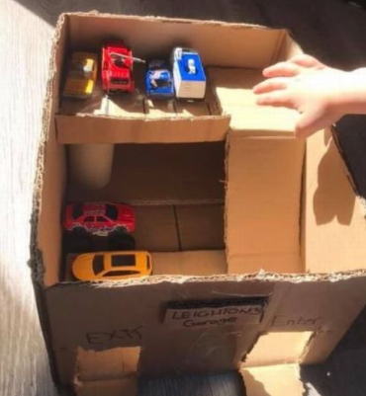
WHAT’S HAPPENING HERE?
Notes:
Jemma

Slide 9
WHAT’S HAPPENING HERE?
EXPRESSIVE ARTS & DESIGN
Constructing to achieve a planned goal.
Using different techniques, e.g. joining materials.
Making use of props to support role play.
Inventing a narrative.
PHYSICAL DEVELOPMENT
Using tools; scissor skills.
Using pencil grip.
Developing hand strength & dexterity through manipulating materials.
LITERACY
Writing their name, signs & labels.
Creating a narrative using story language and structures.
UNDERSTANDING THE WORLD
Applying their experiences through play.
Map making.
Local community and occupations
COMMUNICATION& LANGUAGE
Vocabulary.
Listening and responding to peers in play.
Expressing and explaining their interests, ideas and experiences.
PERSONAL,SOCIAL &EMOTIONAL
Sharing resources and playing/working
co-operatively.
Solving conflicts.
…plus so much more!
Notes:
Jemma

Slide 10
Learning Opportunities Around the Classroom “Discover and Explore!” Date: 22nd Sep 2025
Indoor Continuous Provision
Mark making Felt pens/crayons/ Name cards/ envelopes/ lined and plain paper | Malleable Challenge card – Can you model the play dough into a spider? | Role play Home area | Maths area Sort the lids into sets
Fiddly Fingers Match the identical Numicon shapes | Curiosity Cube / Investigation Spiders, non fiction about mini-beasts | Small world Dolls House
Creative Printing with cotton reels | Construction Continuous provision | Games area Cogs and boards
Outdoor Continuous Provision
Gross Motor Steppers/big feet | Water Sieves, multilink and buckets | Construction Black tray Sticklebricks | Maths Area
Small World Black tray Wooden cars/wooden garage | Mark making Water and large paint brushes | Sand Big plastic minibeasts/wooden logs/sticks/fircones/a branch | Big Builders & Loose Parts
Notes:
Jemma

Slide 11

Learning Opportunities Around the Classroom “Discover and Explore!” Date: 22nd Sep 2025
EYFS Short Term Planning Autumn 1 2025 Week beginning: 18th September
PSED: Continue to be more familiar with routines and show interest in others’ play. Show confidence when making new friends. Continue good hand washing routines and personal hygiene. Intro song. To begin to cooperate with some boundaries and routines. Reference being made to the agreed Class Charter. Lesson 2 – Becoming Boris- Work and play co-operatively together. Listen to one another’s ideas and adapt their play | C&L: Talk about what you know about spiders and express thoughts about them. Practise good listening using our Top Tips. Engage in story/rhyme/song time. Learn to sing 2 verses of Incey Wincey Spider. Super 6 book – NF Spiders Usborne Beginners (Express thoughts and explore new knowledge and vocabulary) | PD: Gross motor: PE-. Intro to PE Unit 1 Storycise and daily use of castle and playtrail to increase core strength and physical confidence. Fine motor: Finger Disco/Funky arms to prepare muscles for effective pencil skills. | Literacy: L&S Phase 1 Aspect 4 – Rhythm and rhyme. To experience and appreciate rhythm and rhyme in speech. Sing and chant Nursery Rhymes daily. Rhyming soup Odd one out (Rhyming words) Rhyming books- Fox got my socks/Sheep gave a leap Recognising their names when voting for a story. Invite children to make marks/write names.
 | Nursery Rhymes Week 3 Incey Wincey Spider / Baa Baa Black Sheep
Maths: Sorting into sets, defining a category. - Sorting lids into sets in different ways. (Eg. Colour, material, size, has print on it.) Use tidying up as an opportunity to practice sorting skills. Sorting into groups Numberblocks Series 1: Episode 10. Cardinal 2 and numeral formation of 2.- Numbertime DVD Num 3 and BBC iplayer Numberblocks – Series 1: Episode 3 -Two Rainbow 2 and draw a face showing 2 eyes, 2 ears, 1 nose 1 mouth. | UTW: Find inspiration in the natural world. Explore the outdoor space for real spiders. Look at the number of legs, colour, etc. And look at webs. Identify/name spiders in non-fiction book. | EA&D: Glue a spider collage using pasta, wood chips, saw dust. etc. Add on 8 legs. Learn and sing two verses of Incey Wincey Spider. Sing There’s a spider on the floor. Music Express p10 My Turn, your turn – with a teddy | Home links: Tapestry uploads Monkey books Library book (For the love of reading) Tracing books
Notes:
Jemma

Slide 12
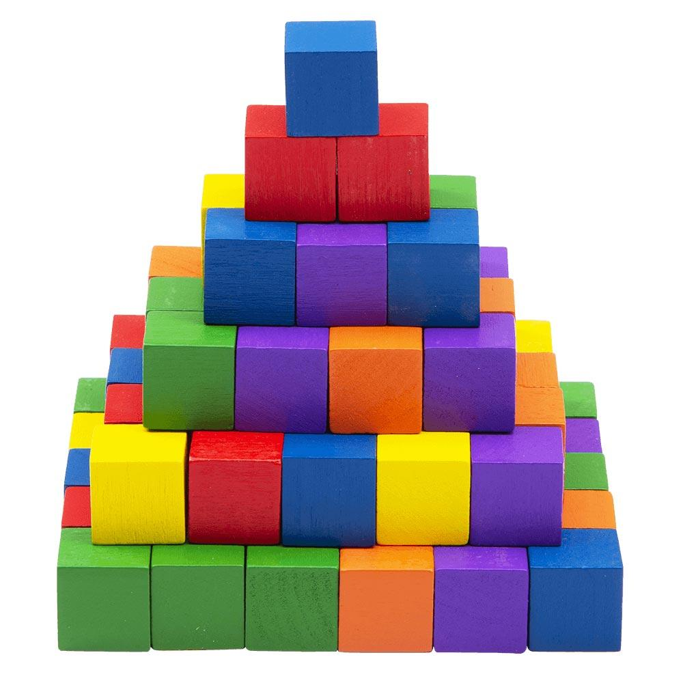
HOW DOES THIS DOVETAIL INTO THE NC?
EYFS – PRIME AREAS | National Curriculum
These three areas underpin all areas of learning and also have specific links to…
Communication & Language | English
Personal, Social & Emotional Development | PSHE RHE
Physical Development | Literacy (writing) P.E. DT Art & design
EYFS – SPECIFIC AREAS | National Curriculum
Literacy | English
Maths | Maths!
Understanding the World | Science Geography History RE Computing
Expressive Arts & Design | Art DT Drama Music
Notes:
Jemma

Slide 13
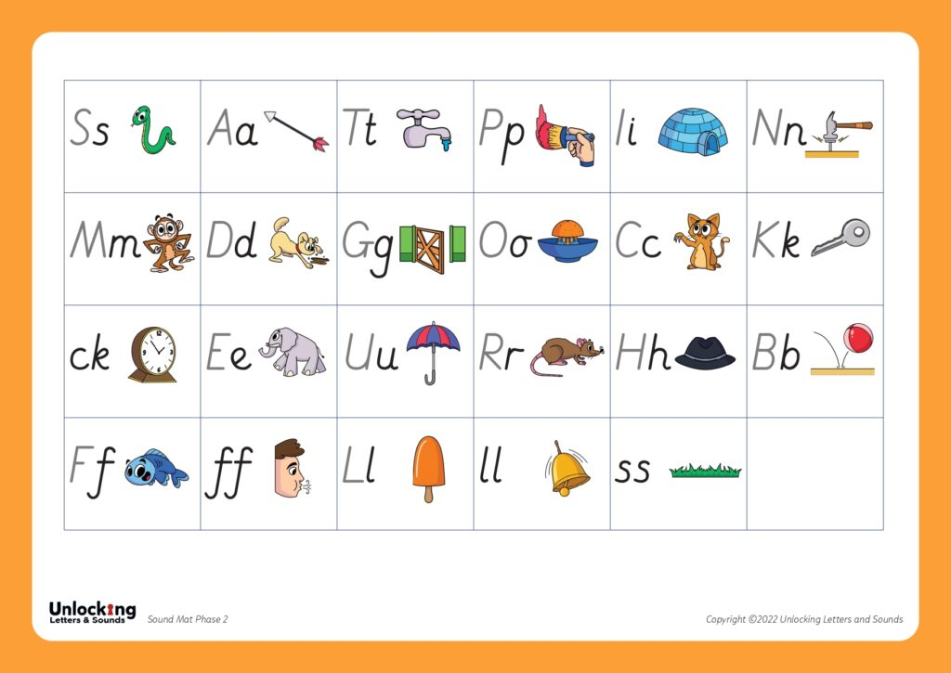

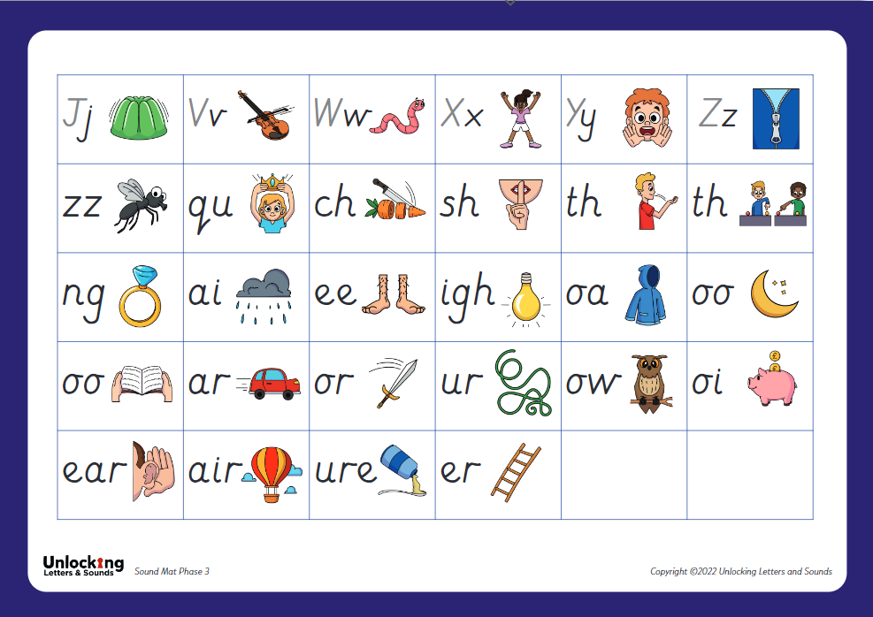
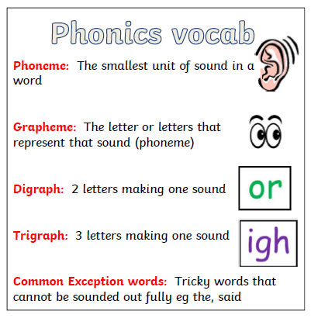
ULS will support your children to read, spell and write fluently and quickly. The programme has been created by practising teachers who teach phonics every day.
Notes:
Helen
Explain how each sound has an action to aid memory and how the reading scrap books/pink books will also help the ch to store this new info into their long term memory.

Slide 14
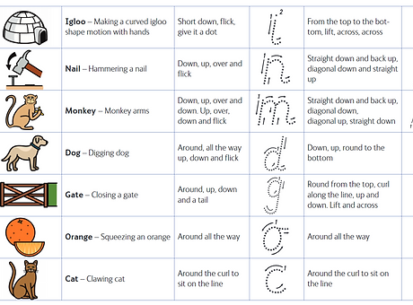

Let’s use our phonemes and actions to sound out the title of this book!
Notes:
Helen

Slide 15

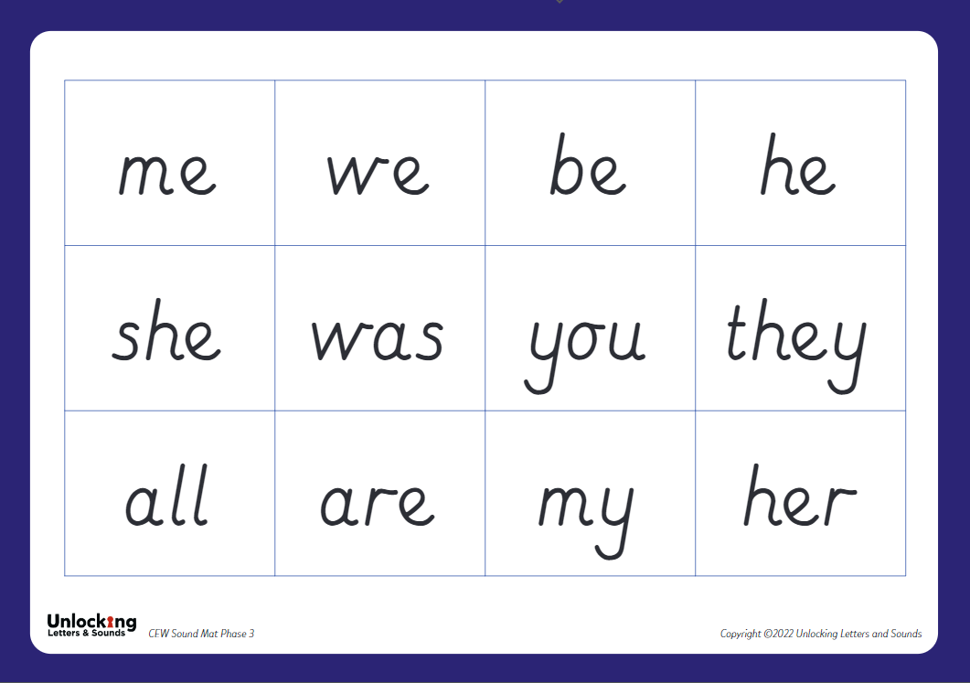
Common Exception Words
Notes:
Helen

Slide 16
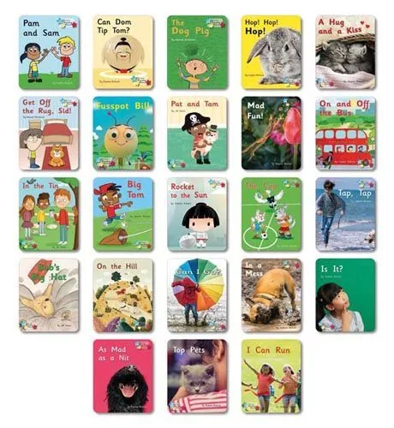
Reading Stars Phonics
Notes:
Jemma
Show an example of the book on the IWB ULS website, explain why they are so simple - decodable….indep ch, sense of achievement. Try to read at least 3 times. Will also get a library book to encourage love of reading. Changed once a week - Monday.

Slide 17
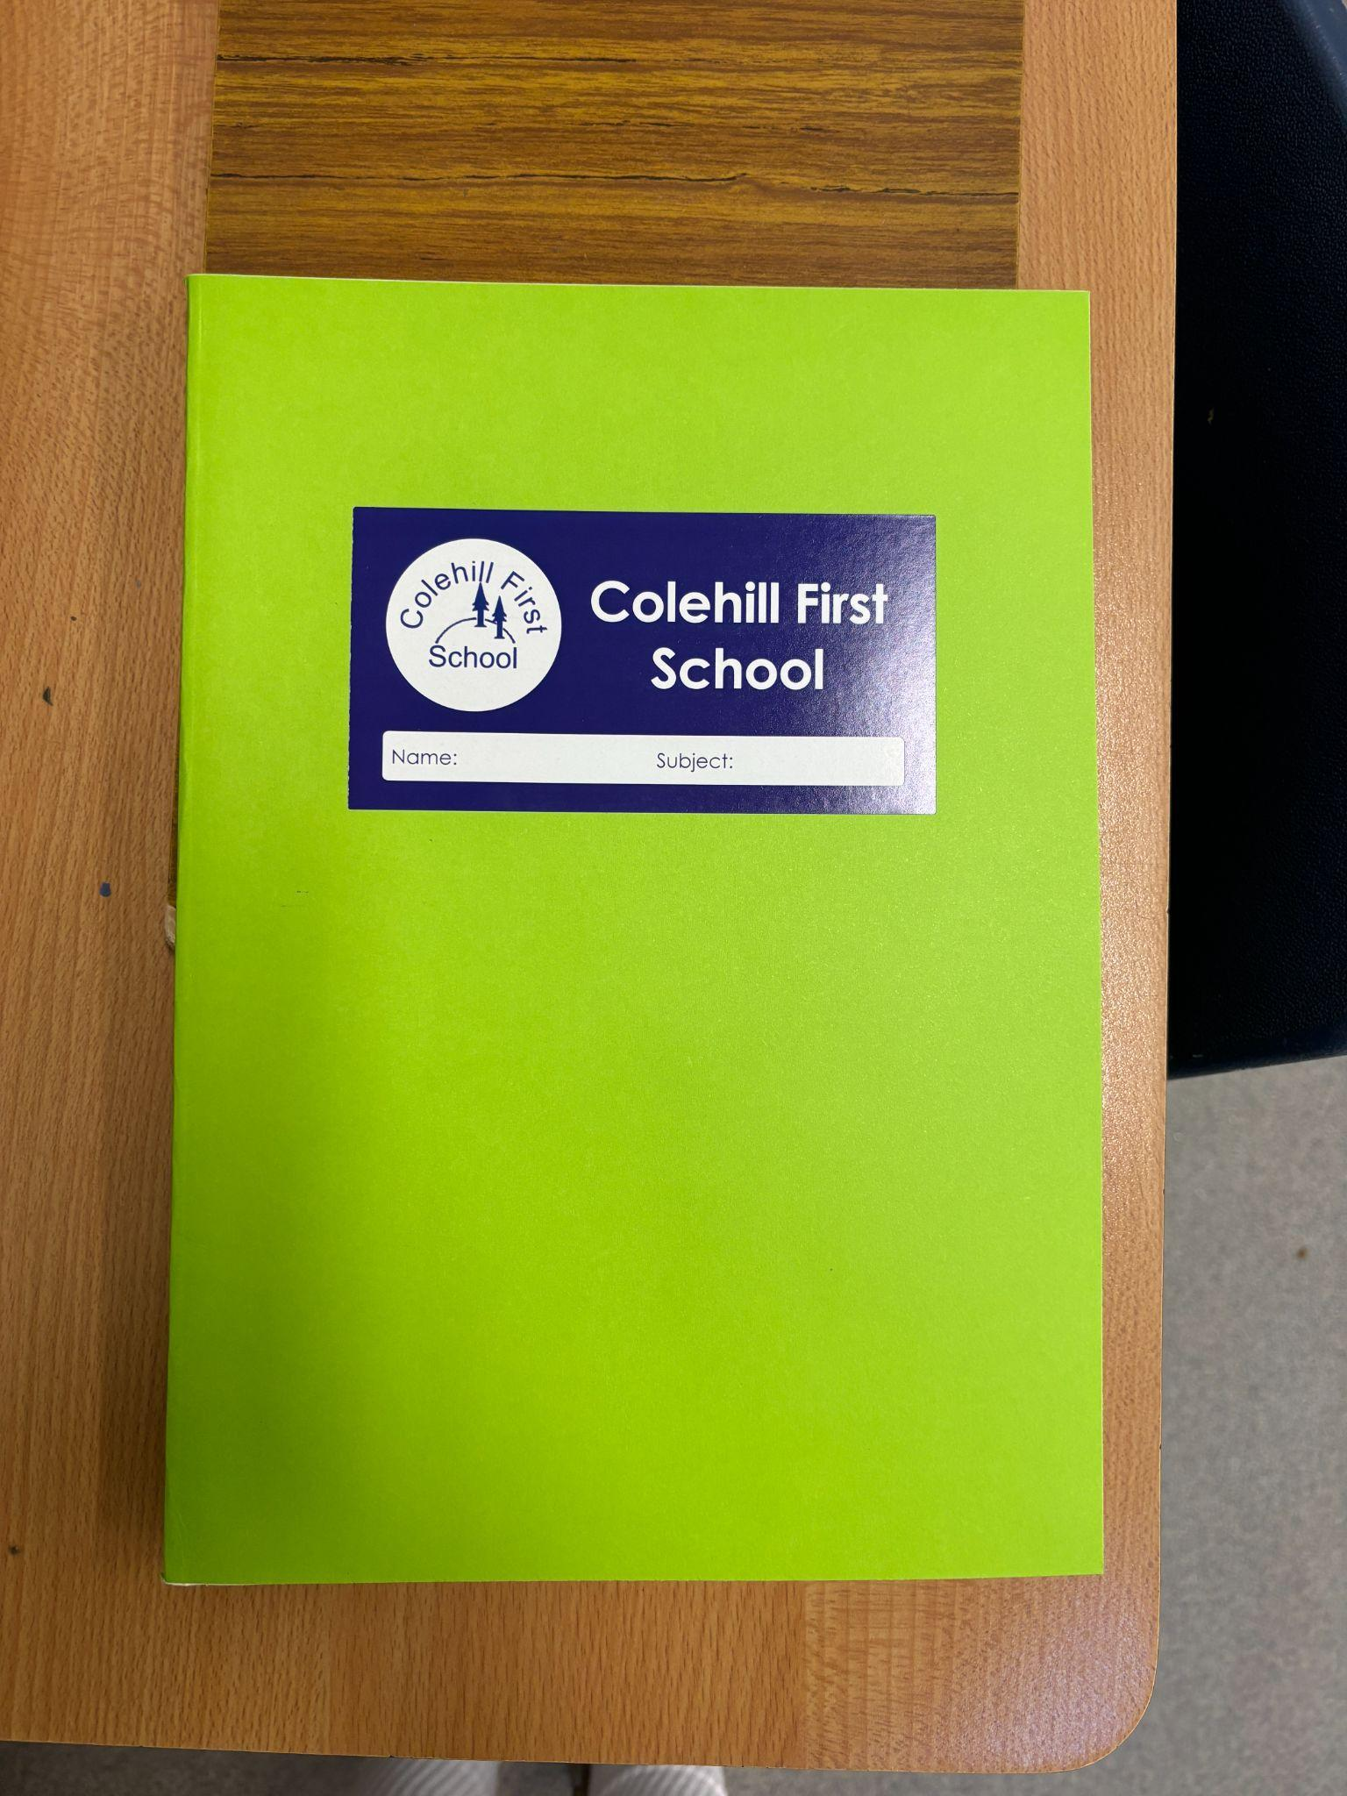
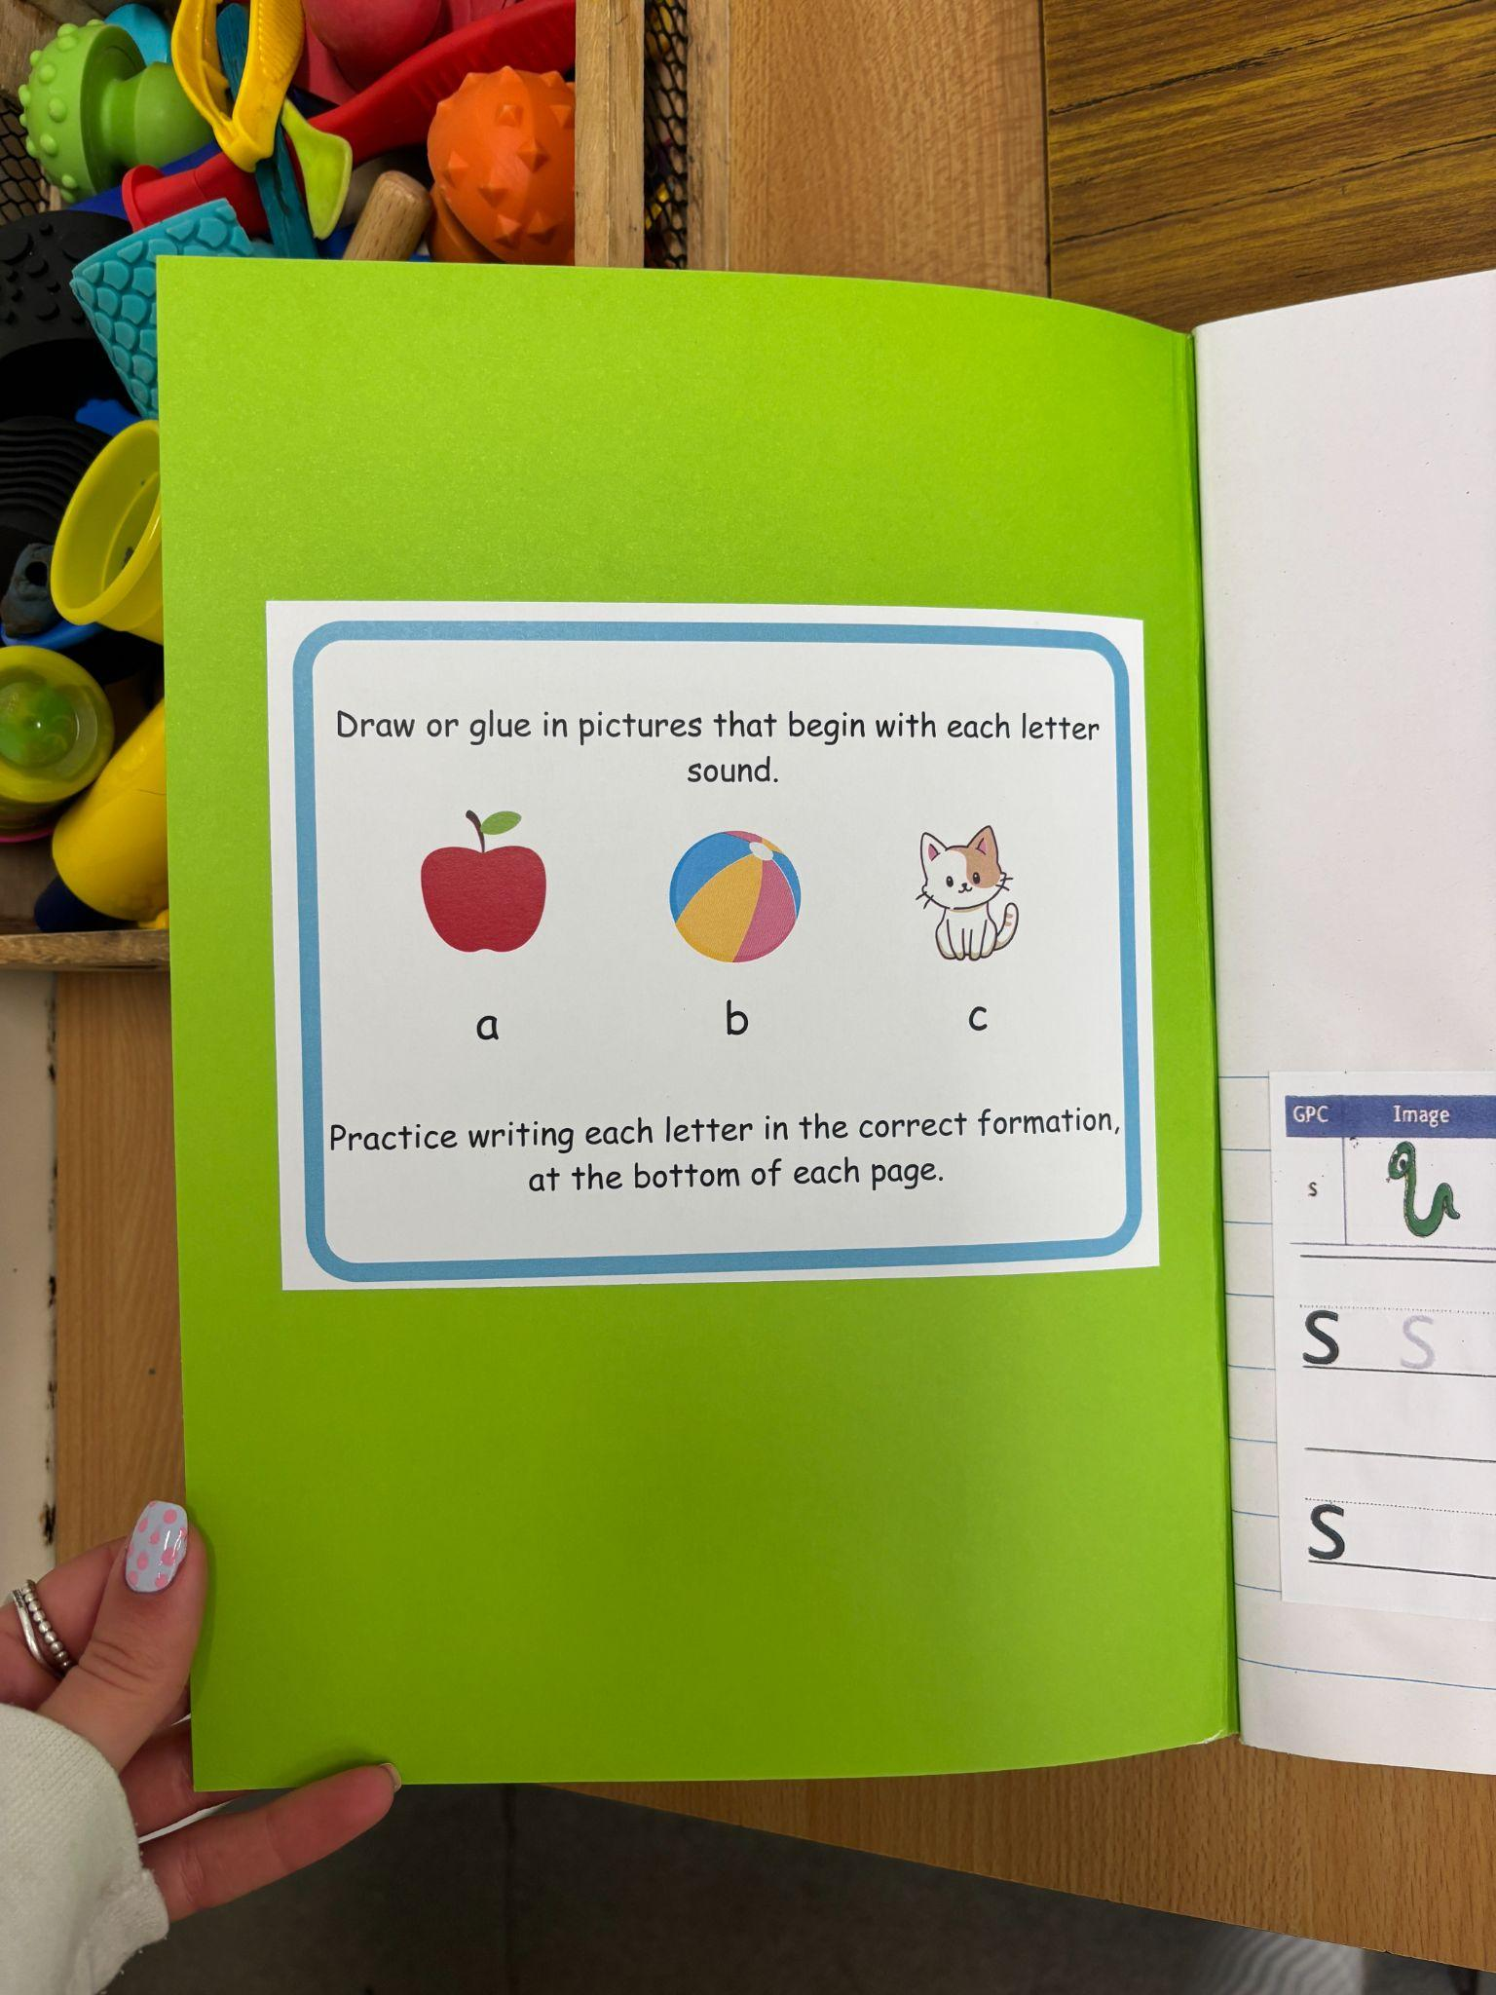
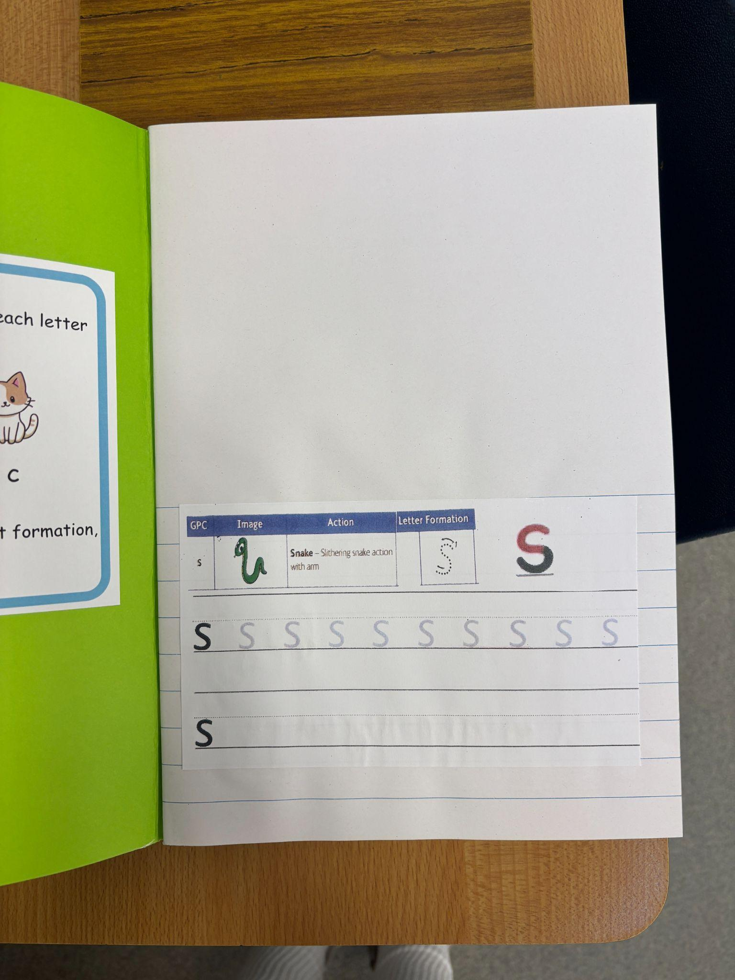
Phonics scrapbook
Notes:
Jemma- coming home on Friday
Show an example of the book on the IWB ULS website, explain why they are so simple - decodable….indep ch, sense of achievement. Try to read at least 3 times. Will also get a library book to encourage love of reading. Changed once a week - Monday.

Slide 18
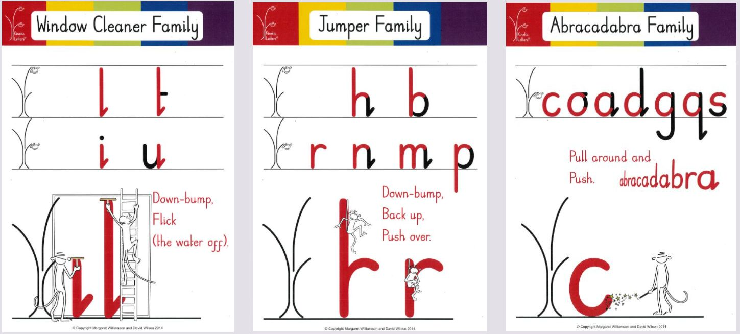
Kinetic Letters
Notes:
Jemma
Name practice and tracing books to come home soon. Letter formation in phonics books
Strong bears, penguins

Slide 19
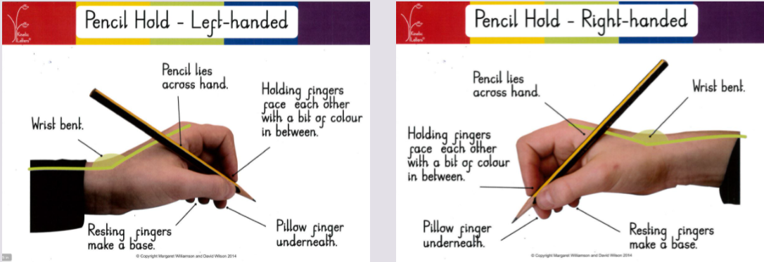
Pencil Hold
Notes:
Jemma
Name practice- important to use the correct hold

Slide 20

Thank you for your time!
Notes:
Show an example of the book on the IWB ULS website, explain why they are so simple - decodable….indep ch, sense of achievement. Try to read at least 3 times. Will also get a library book to encourage love of reading. Changed once a week - Monday.

