Slide 1
Reading Fluency

Slide 2
Reading fluency can be defined as reading with:
Automaticity – the ability to read words quickly.
Accuracy – the ability to read words correctly
Prosody – the appropriate use of intonation, phrasing and expression.
Notes:
Accuracy: Reading accurately means to decode and read words correctly. It is the ability to apply knowledge of letter sound relationships when reading written words. Pupils’ level of accuracy will impact their speed and ease of reading.
Automaticity: The more cognitive space that is taken up with trying to decode words, the less space there is available to comprehend meaning in a text. Therefore, readers must be able to decode words without thinking about the decoding. Reading with automaticity is reading words on sight automatically and at an appropriate pace. It feels and sounds effortless for pupils.
Prosody
is reading aloud (and silently) with proper stress, intonation, and expression.
It depends on accurate reading and comprehension.
Appropriate expression and phrasing require understanding the meaning of the text.
Knowing the words and ideas helps readers adjust volume, smoothness, and pace to convey emotion, emphasis, or tone.
Reading with prosody sounds engaging and interesting to listeners.

Slide 3
Why is fluency the focus?
Fluency is a key skill that connects decoding to true comprehension.
Non-fluent readers use most of their energy sounding out words, leaving little for understanding meaning.
Fluent readers read with speed, accuracy and expression, helping them group words into meaningful phrases and focus on ideas, plot, and main points.
Fluency reduces frustration and builds confidence.
Research shows many struggling secondary readers also have fluency difficulties.

Slide 4
What are we trying to achieve in reading lessons?
Develop/build children’s reading fluency
Increase pupils understanding of written English & the world to which it relates - read plenty of thoughtfully chosen texts
Develop pupils’ understanding of their subjective, strategic role in interpreting and appreciating texts by discussing texts in depth

Slide 5


Slide 6
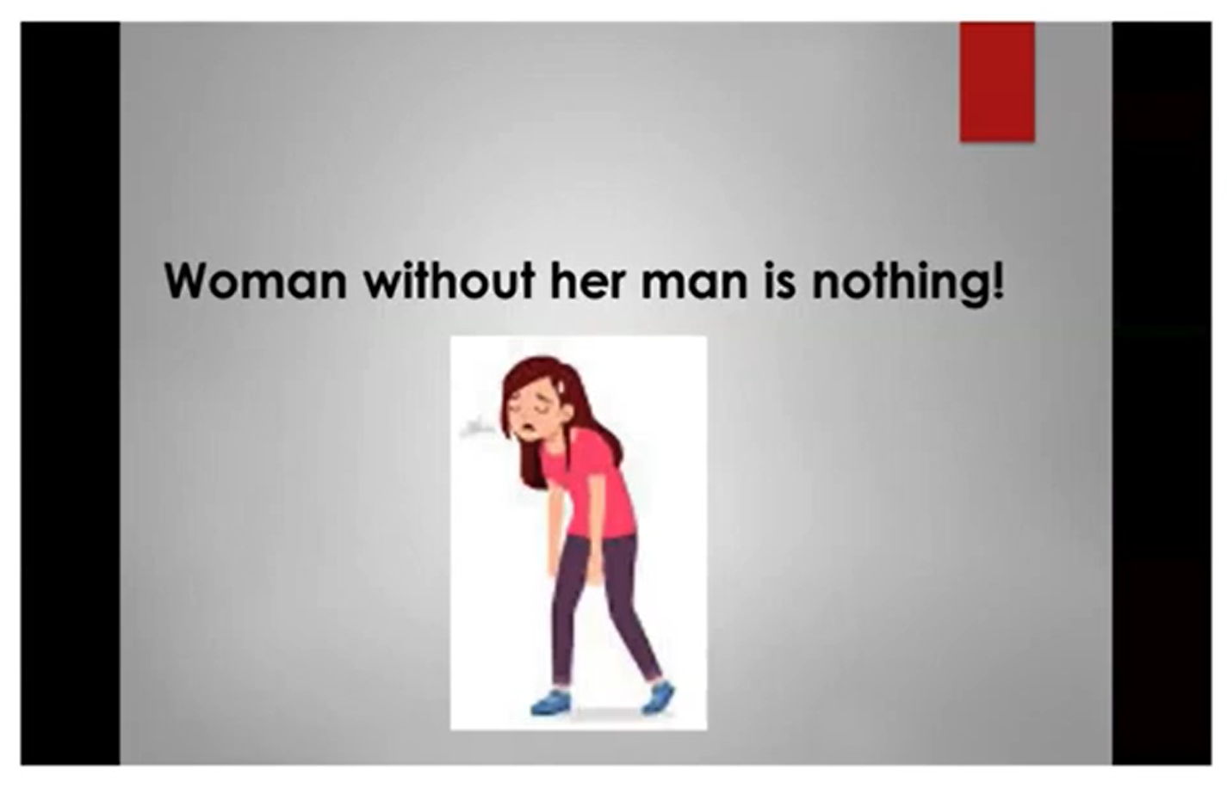
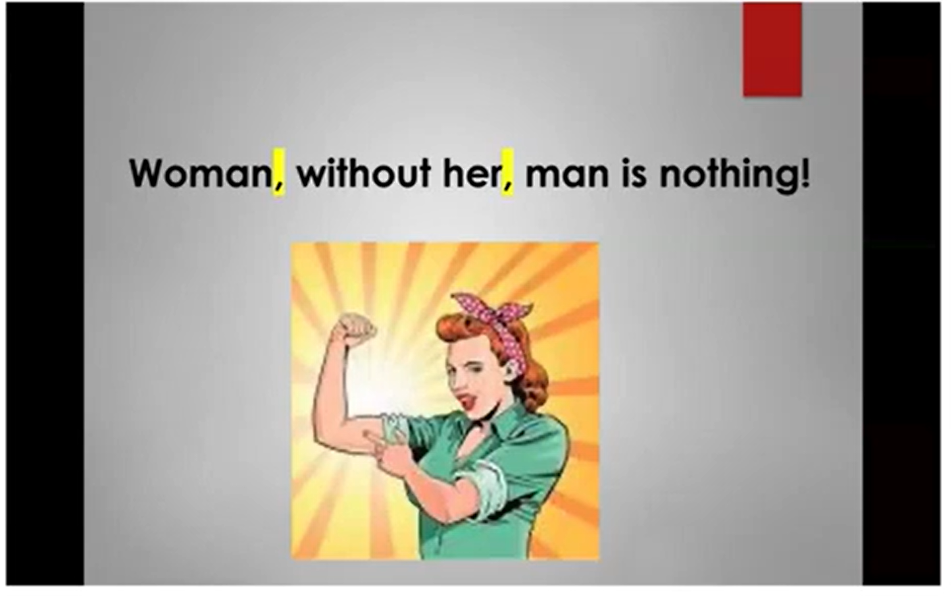

Slide 7
What is the right balance of reading lesson structures?
The balance of reading lesson structures ensures pupils are developing:
fluency
reading broadly
discussing text
in proportions that are roughly appropriate for their stage of development.
Notes:
Pupils who are at the earliest stages of reading fluency are likely to benefit most from regular fluency reading lessons alongside some extended reading lessons.
Pupils who are approaching reading fluency are likely to benefit most from a roughly 50-50 split between fluency lessons and extended reading lessons with occasional close reading lessons.
Pupils who are relatively fluent readers are likely to benefit most from a roughly 50-50 split between extended reading and close reading lessons with occasional fluency reading lessons.

Slide 8
Three different core lesson structures
(approx 25 min sessions)
Fluency Reading - targets reading aim 1
An explicit focus on fluency development through active decoding.
Extended Reading - targets reading aim 2
Building reading experience. Providing pupils with a breadth of reading experience.
Close reading - targets reading aim 3
Text discussion

Slide 9
The IDEAL timetable
 | Monday | Tuesday | Wednesday | Thursday | Friday
Early stages of fluency | Fluency reading | Extended Reading | Fluency reading | Extended Reading | Fluency reading
Approaching fluent reading | Fluency reading | Extended Reading | Fluency reading | Extended Reading | Close Reading
Relatively fluent reading | Fluency reading | Extended Reading | Close Reading | Extended Reading | Close Reading

Slide 10
Fluency Reading - Key Steps
Use modelling, practice & feedback to build fluency.
Pair pupils in mixed-attainment pairs with one shared text.
Select a 1–2 minute chunk and briefly place it in context.
Model the text twice: first for prosody, second with pupils following.
Pre-teach up to 5 key words (definitions, pronunciation, pictures).
Use echo reading if needed, then paired rehearsal (partners track the text).
Pupils read the text three times each, improving flow while maintaining accurate decoding.
Set expectations: rehearse for understanding, use quiet, partner-only volume.
Teacher circulates during ~15 minutes of repeated reading.
End with a short whole-class read (volunteers or selected readers).
Finish with brief comprehension discussion.

Slide 11
Extended Reading
Pupils engage with large amounts of text, supported or independent, with brief explanations/questions that don’t break immersion.
Use the same text over many lessons (e.g., a story over several weeks).
For early-stage readers:
Teacher reads aloud while pupils track the text in their own copy or under a visualiser.

Slide 12
Extended Reading - Key Steps
Before reading:
Put upcoming reading in context: introduce the title/cover or recap previous lesson.
During reading:
Read aloud; pupils follow with a finger/ruler.
Pause only to explain essential points and ask quick questions that check basic understanding.
Keep discussion to about one-third of the lesson.
Use a consistent routine to transition between reading and discussion.
When texts become challenging:
Model strategies: reread, ask clarifying questions, summarise, and think aloud.
For more developed readers:
Begin with teacher-led reading, then introduce quiet independent reading of short chunks.
Pre-teach tricky vocabulary/background knowledge.
If they finish, pupils write a one-sentence summary, then reread to check accuracy.
Gradually increase chunk length; decide which parts are independent and which are read aloud.

Slide 13
Close Reading
Aim: deepen pupils’ analysis of how authors use language and its effect; help pupils understand themselves as readers.
Focus: 1–2 chunks (paragraph → few pages) or a recurring language pattern
Context: Briefly situate the extract or whole text (type, place in text, etc.).
Read vs Discuss: Spend little time reading; most time on discussion and analysis.
Reading methods: Mix teacher read-aloud, paired reading, or independent reading as needed.
Explain sparingly: Clarify only what pupils cannot infer with support.
Questioning: Probe themes, underlying meanings and authors’ language choices; allow pupils to give opinions and personal responses.
Active thinking: Use Think–Pair–Share, mini-whiteboards and short written answers to ensure all pupils engage.
Flexible exploration: Let discussions extend beyond planned points, then return to planned themes/language.
Model strategies for difficulty: When text is hard, demonstrate rereading, targeted questioning and summarising—think aloud your reasoning.

Slide 14
How can reading fluency be developed?
Guided oral reading
Guided oral reading instruction is when fluent reading of a text is demonstrated by an adult or peer, modelling the 3 Ps (pronunciation, phrasing and prosody). Pupils then read the same text aloud with appropriate feedback.
Repeated Reading
Repeated reading is when pupils re-read a short and meaningful passage a set number of times or until they reach a suitable level of fluency. Strategies such as choral or echo reading can help to provide oral support for reading for pupils.

Slide 15
Useful Strategies
Echo reading
Choral/Shared Reading
Paired repeated readings
Books on iPad: Have children follow along as the book is read, reading with the narrator where possible. Enable the phrased highlighted reading to help readers follow along.
Repeated readings: As a child reads a passage at his or hers instructional level, the teacher times the reading. The teacher then gives feedback on word recognition, phrasing, and the number of words read per minute the child read accurately and records the data on a graph. The child practices reading the same selection independently or with partner. The process is repeated and progress is plotted on graph. This also help with sight word recognition.

Slide 16
Link to year 3 slides

Slide 17
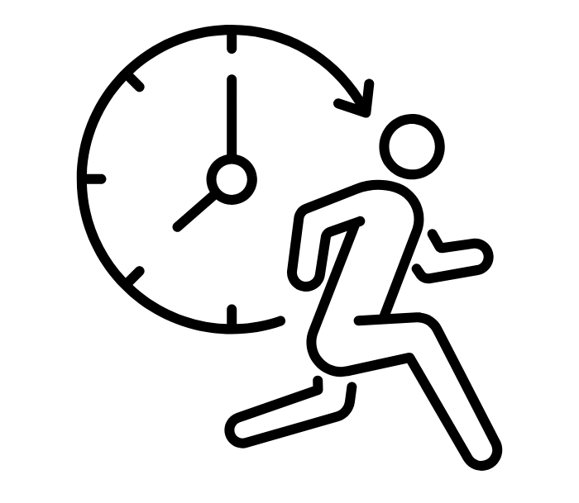

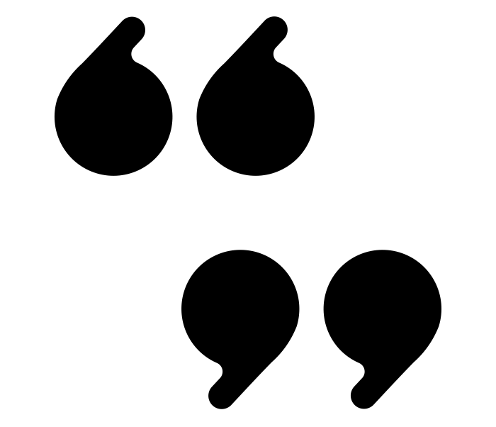





6 P’s:
pace
pitch
pauses
punctuation
personality
power

Slide 18
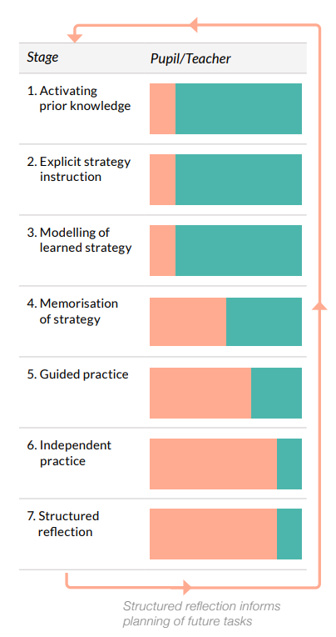
The Gradual Release Responsibility Model
(EEF Metacognition & Self -regulated Learning report)
Helping struggling readers to reach independence
Notes:
https://d2tic4wvo1iusb.cloudfront.net/eef-guidance-reports/metacognition/Seven_step_model_1.0.pdf?v=1644475400
The ​‘gradual release of responsibility’ model that is exemplified in EEF ​‘Metacognition and Self-regulated Learning’ guidance report, helping struggling readers to reach independence in a supportive, intentional way
The orange part of the bar represents the pupil and the turquoise part represents the teacher input.
All 7 steps could take place in a single lesson or it may be more appropriate for them to occur over a series of lessons.
https://d2tic4wvo1iusb.cloudfront.net/production/eef-guidance-reports/metacognition/Seven_step_model_worksheet_1.0.pdf?v=1757690741

Slide 19
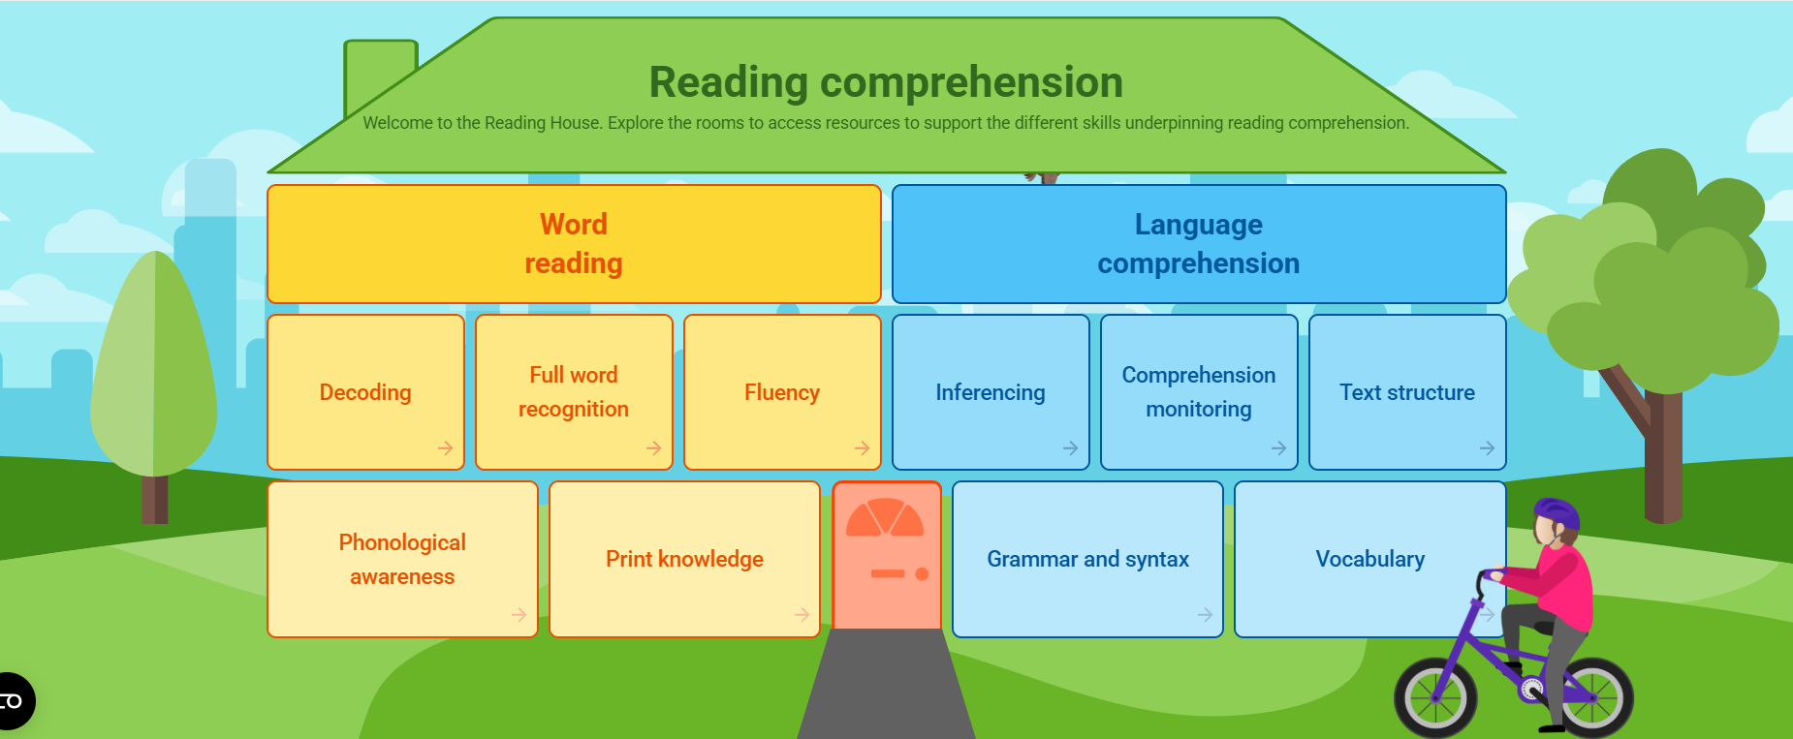
The Reading House

