Slide 1
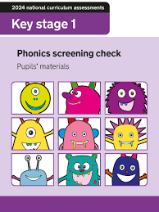

Phonics Screening Check Meeting

Slide 2
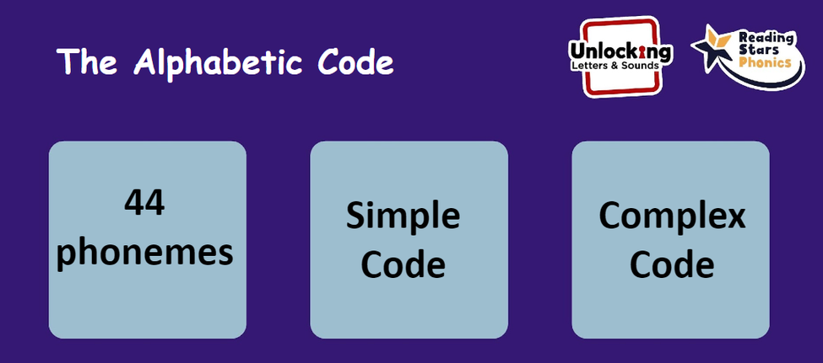
Phonics language
Single Phoneme ‘J’
Diagraph ‘ai’ (2 letters make one sound)
Trigraph ‘igh’ (3 letters make one sound)
Grapheme - how we spell the phomene
e.g. ai/ay/ey/a_e/a
Blending for reading
Pushing the phonemes together to make a word.
Cat
Tree
Segmenting for Spelling
Breaking words down into their individual sounds or phonemes

Slide 3
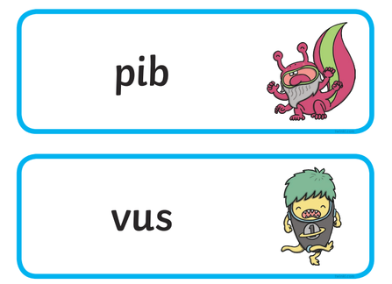
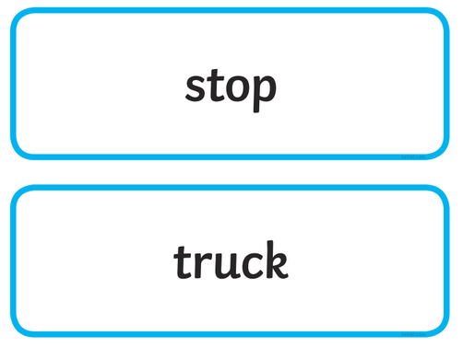
What is the Phonics Screening?
All Year 1 pupils will take the phonics screening check in June
• It comprises of a list of 40 words; 20 real words and 20 nonsense words.
• It will assess phonics skills and knowledge learnt through reception and year 1.
• Your child will read the test in a one to one situation. They will read up to 4 words per page and they will probably do the check in 10‐15 minutes. They will be asked to ‘sound out’ a word and blend the sounds together to read the word. The children have plenty of exposure to nonsense words so they are well prepared for the test.

Slide 4
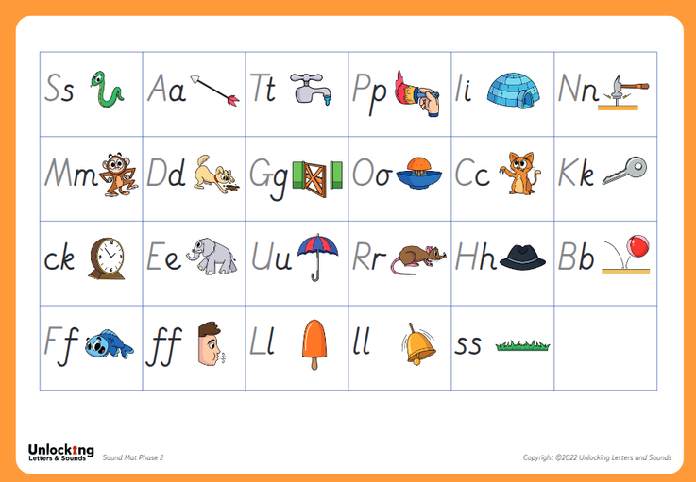
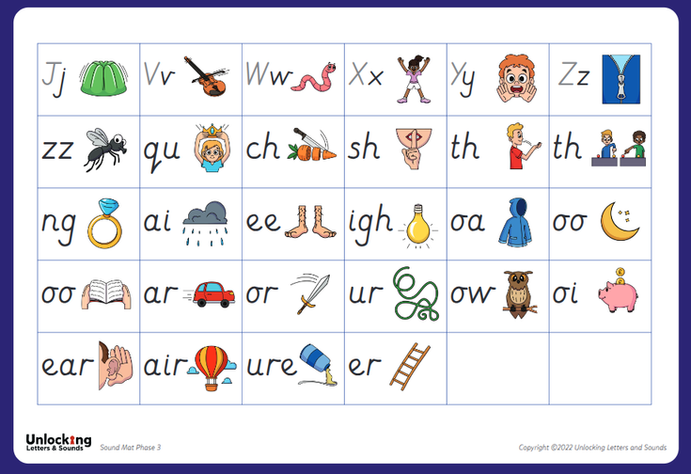
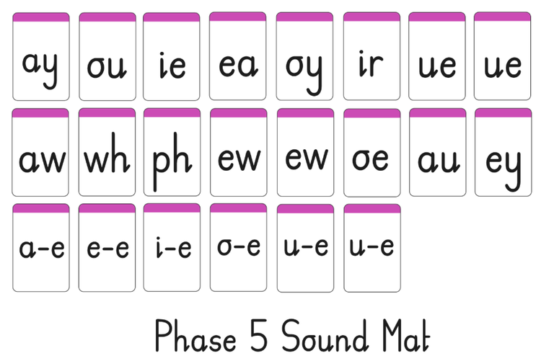
How to pronounce the sounds
https://www.unlockinglettersandsounds.co.uk/institute/teacher/courseview/13/view

Slide 5
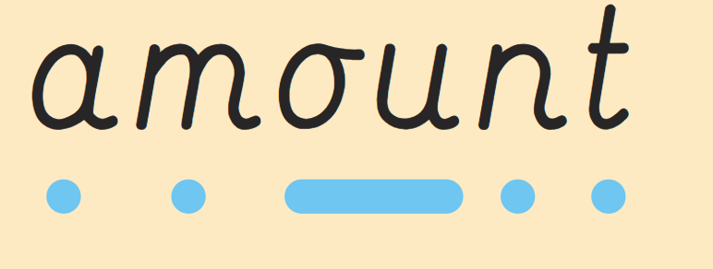
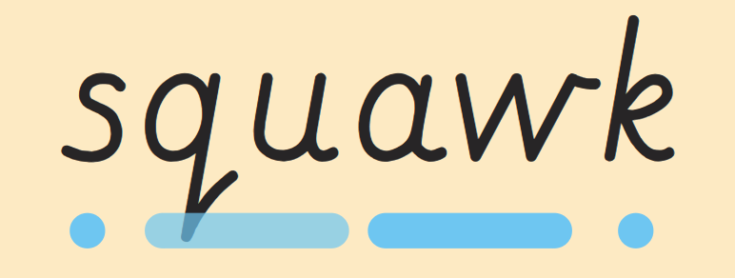
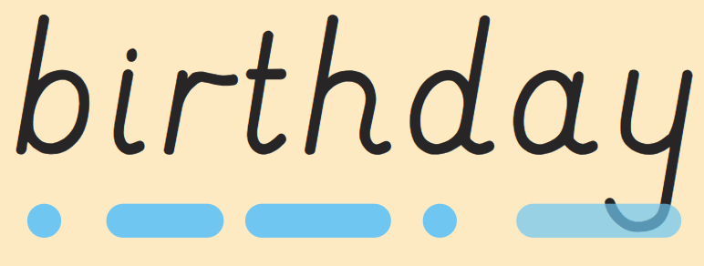
What are sound buttons and how do we use them?

Slide 6


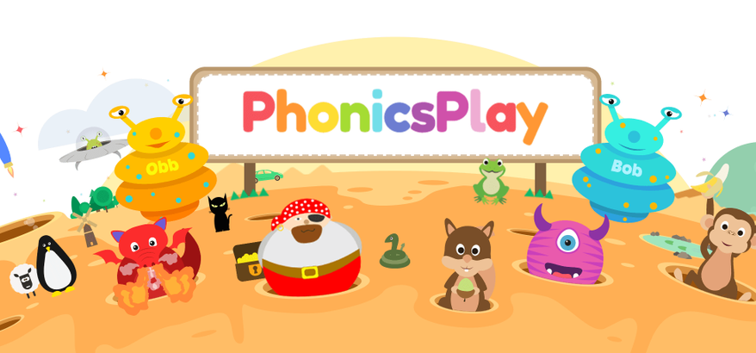
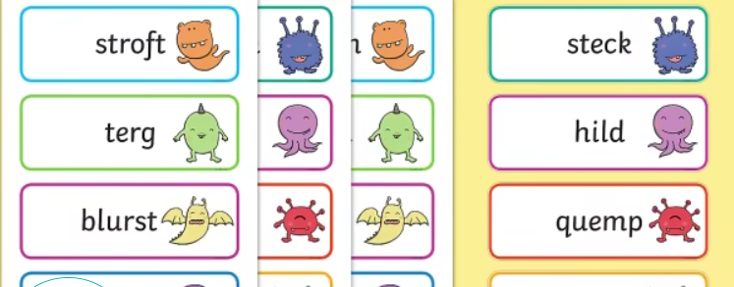

How can you help prepare your child for the phonics screening check?
Phonics Play

Slide 7
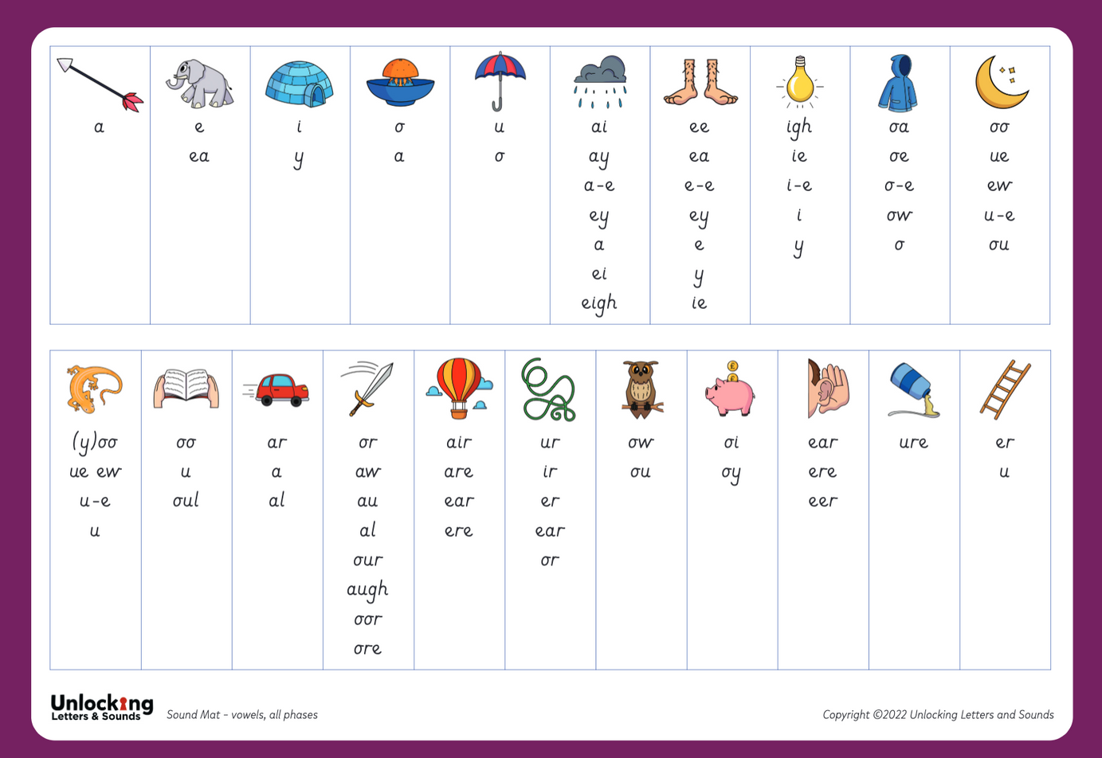
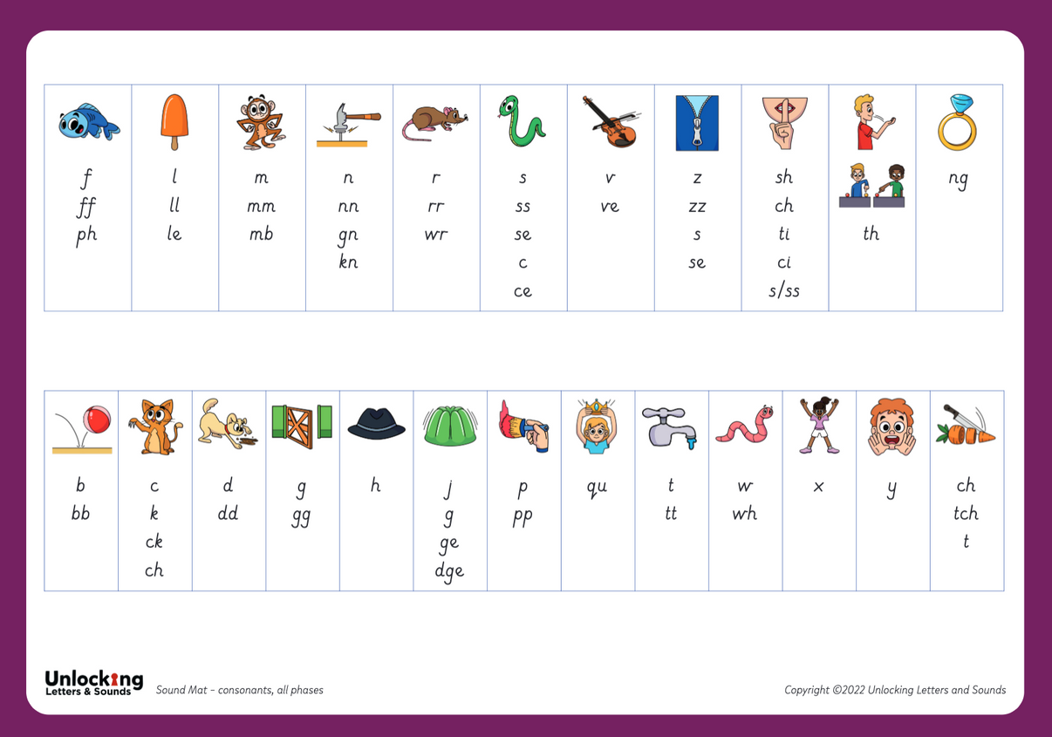

Slide 8
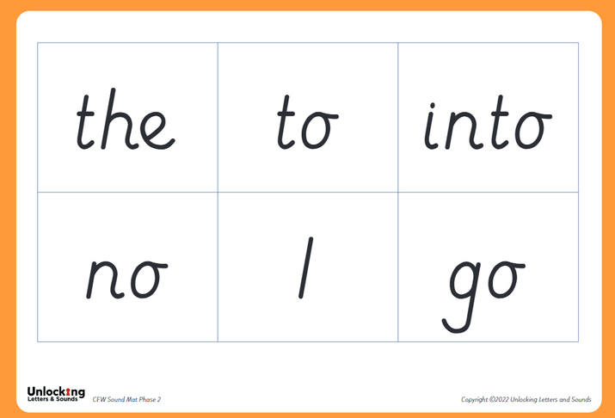
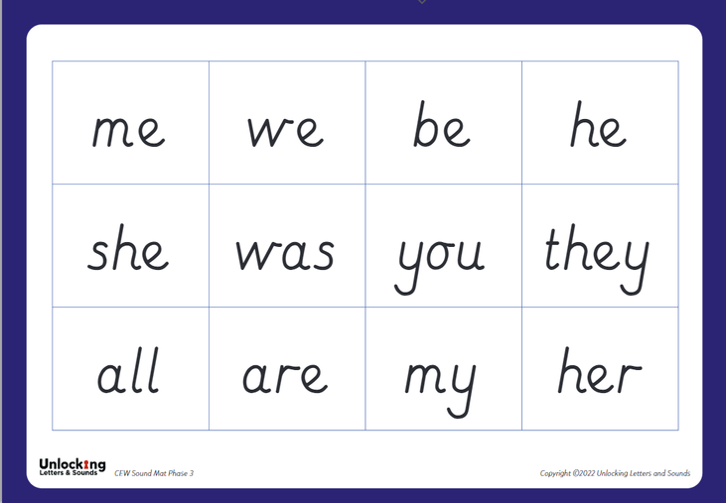
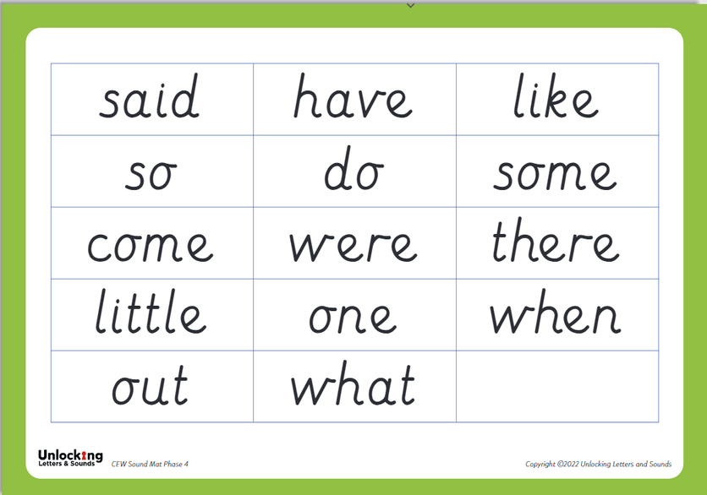
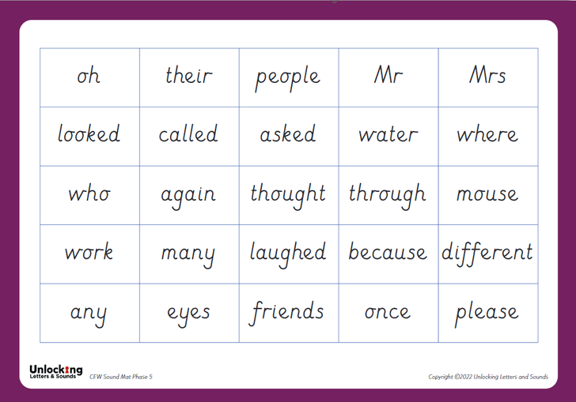
COMMON EXCEPTION WORDS

Slide 9
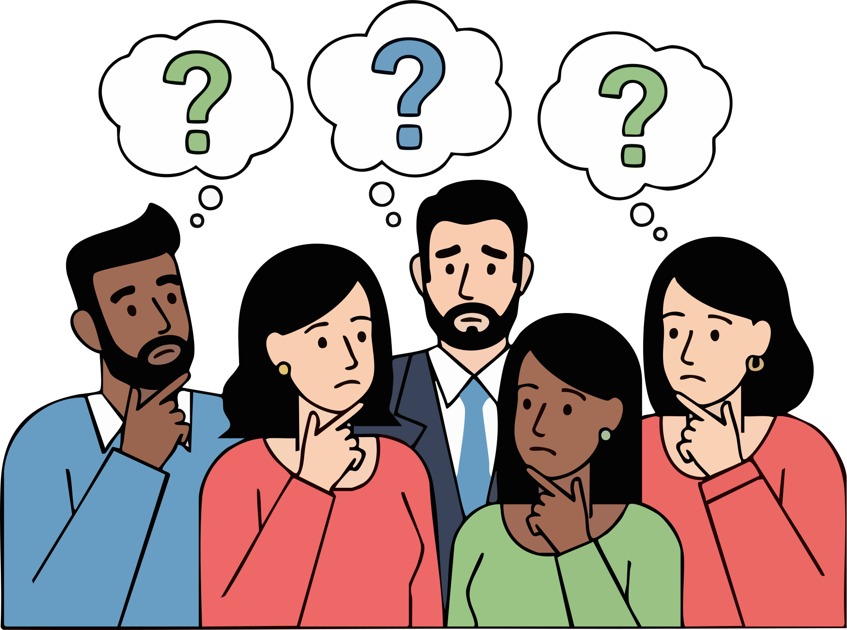
Any questions?

